Slide 1


Automatic System Tuning for Distributed Stream Processing
Morgan Geldenhuys, Dominik Scheinert, Odej Kao, Lauritz Thamsen*
Technische Universität Berlin, University of Glasgow*
2 May 2024

Slide 2
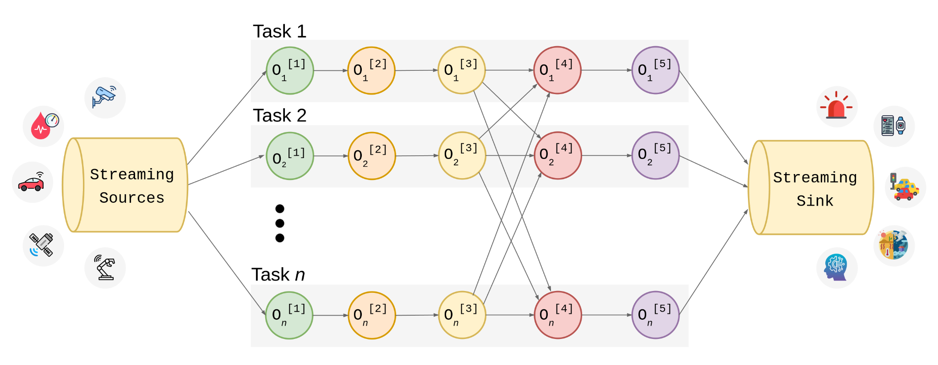
Background:
Distributed Stream Processing
Notes:
Distributed Stream processing is the real-time processing of high velocity, high volume data to extract value in near-real time which is critical to time-sensitive decision making.
Storm, Flink, Spark
It is here where the results lose value the more time goes goes by, so the data is not stored in a database, but processed as fast as possible.
Data volume is too large to process it on a single machine, so therefore it is partitioned and processed by parallel processing tasks.
Each task executes a DAG (Directed Acyclic Graph), a sequence of operators responsible for transforming, filtering, and aggregating the data.
Common streaming sources: IoT, social media platforms, financial transactions, logs and network events, etc.
Use Cases: Real-Time Analytics, Fraud Detection, Predictive Maintenance, Personalization and Recommendation, Network Monitoring and Optimization, Event-driven marketing

Slide 3
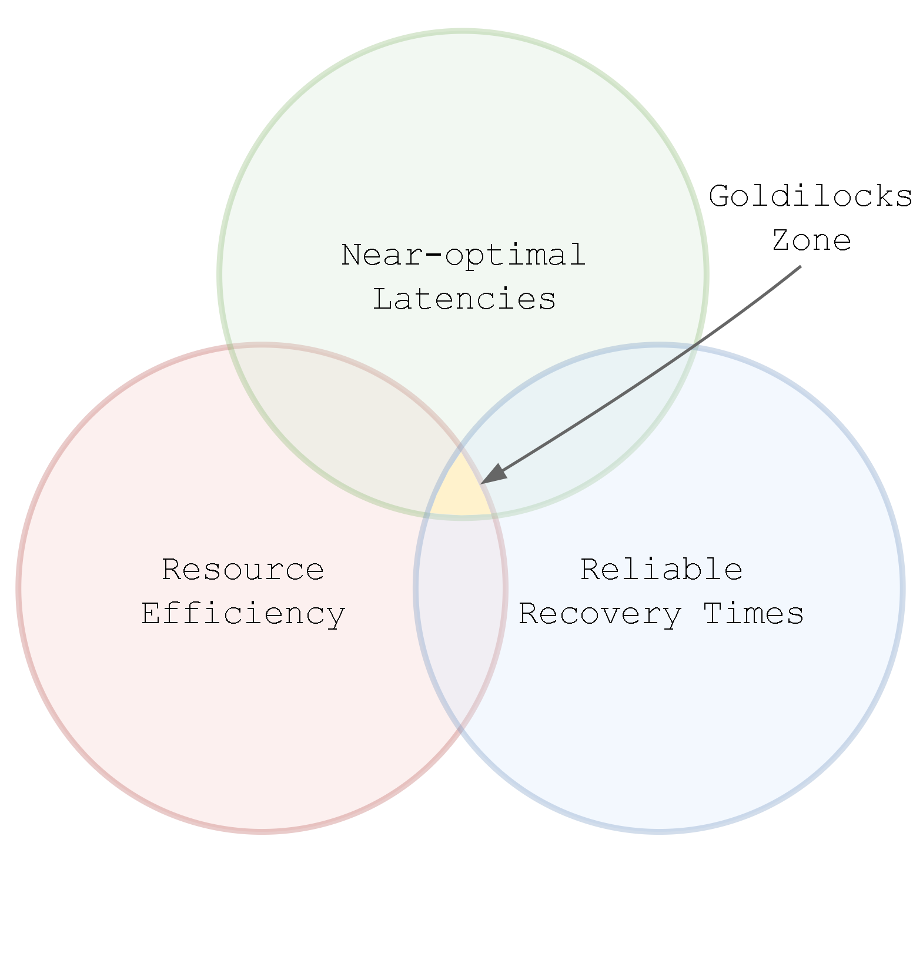
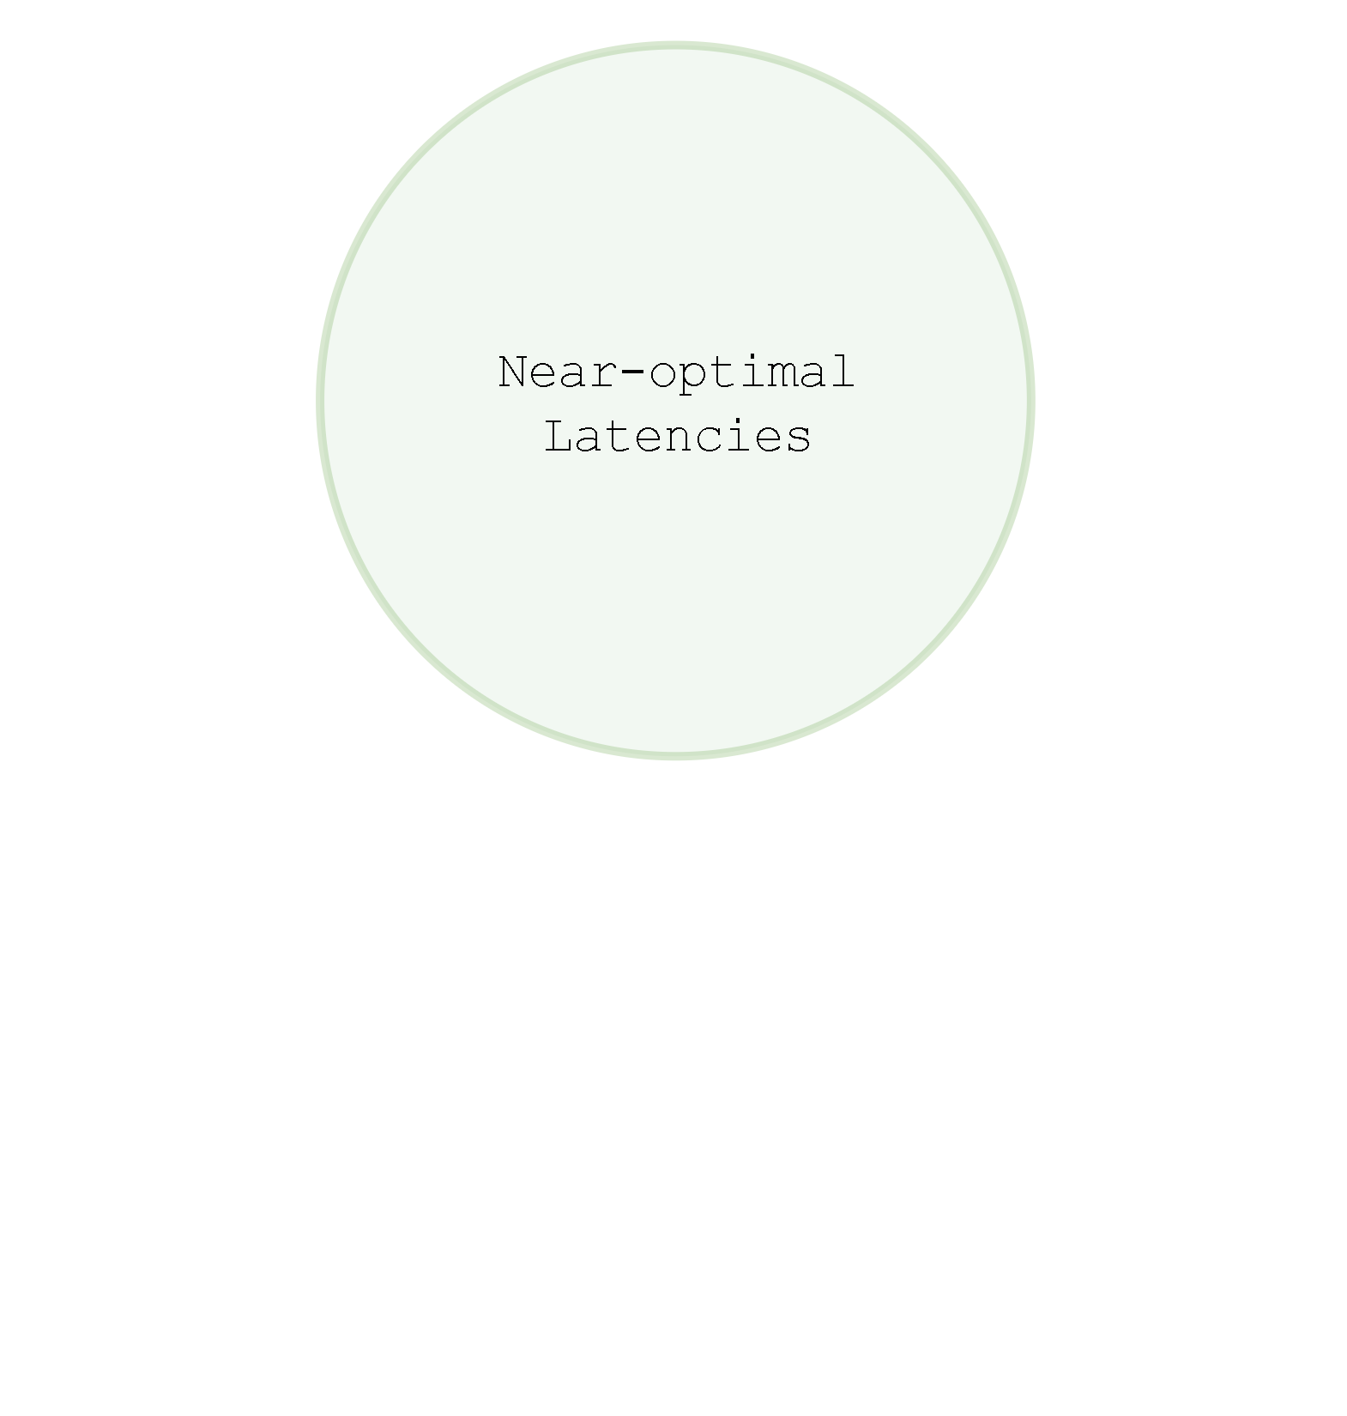
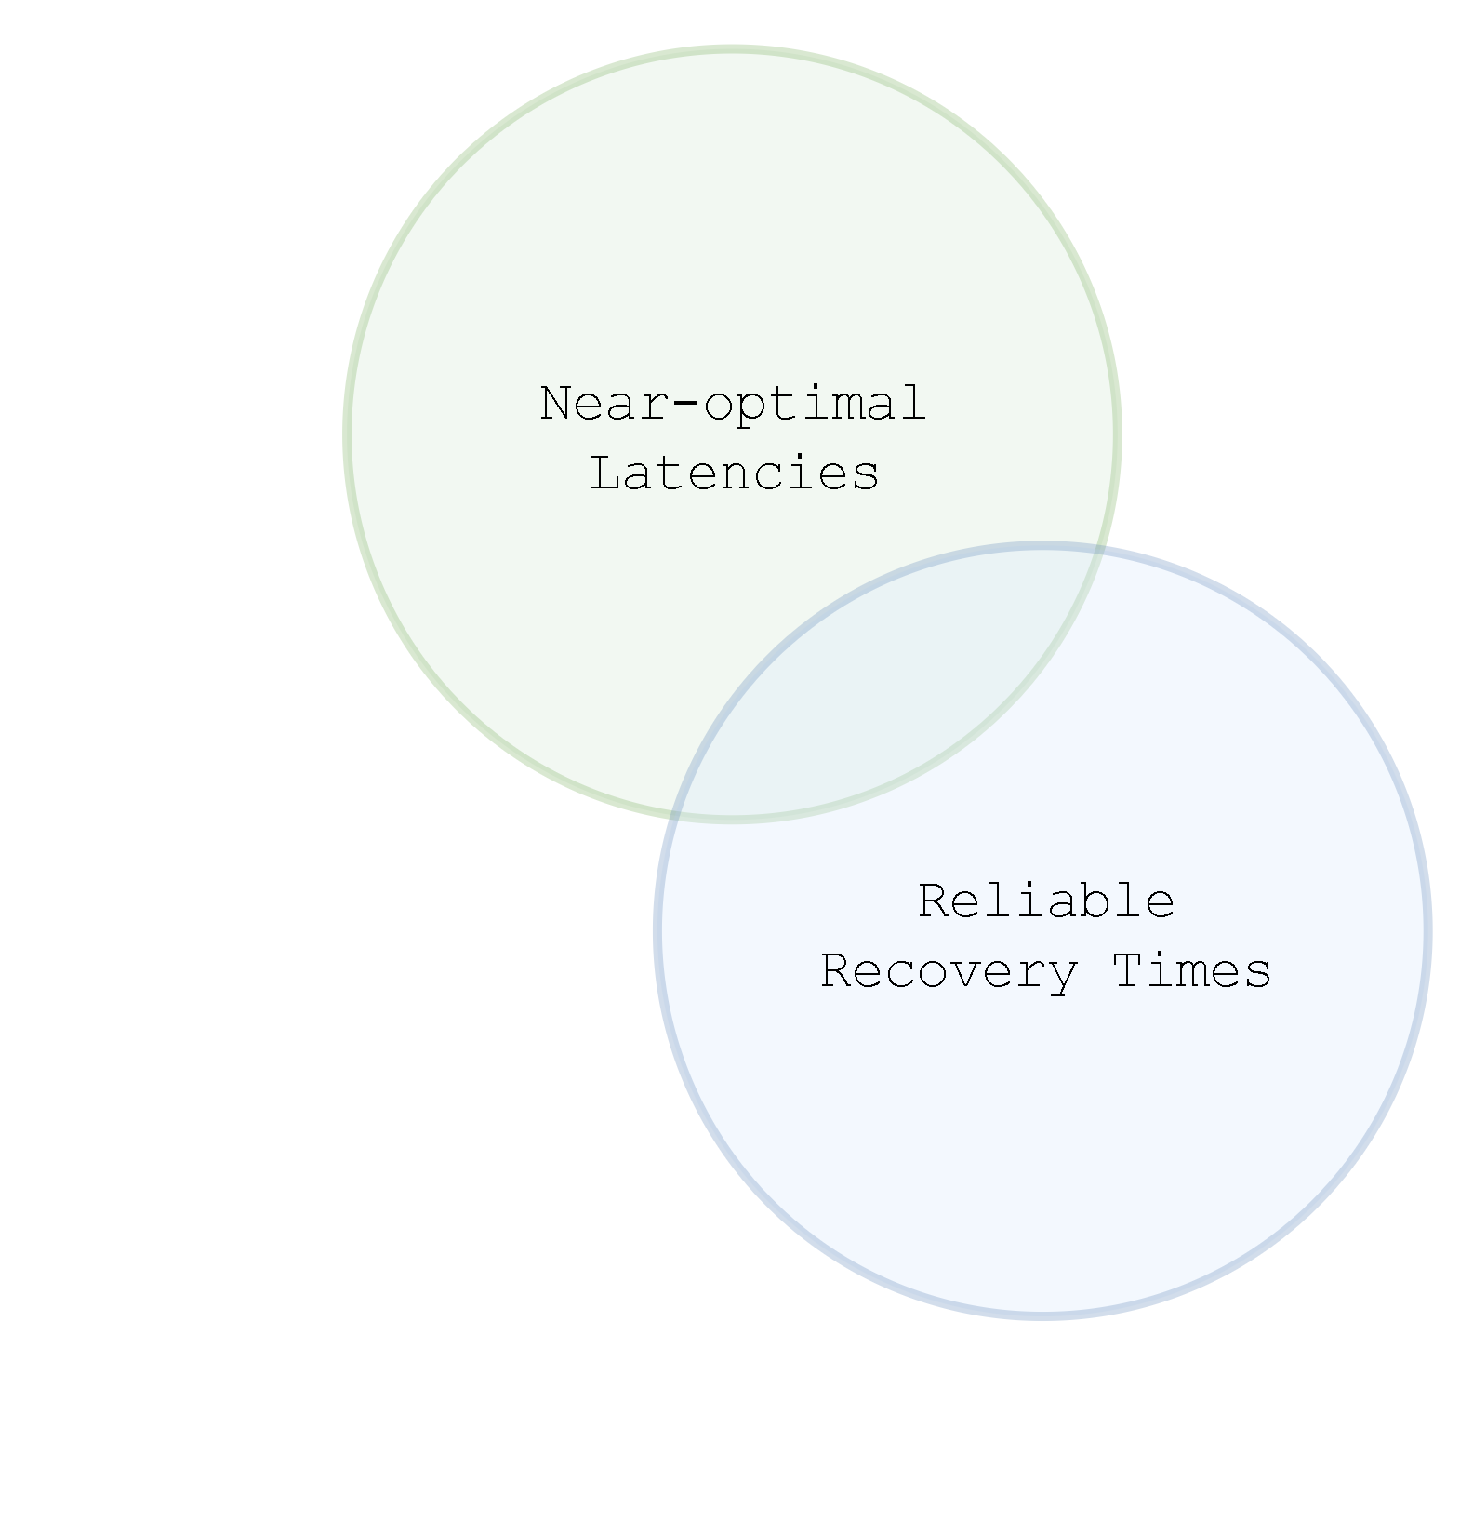
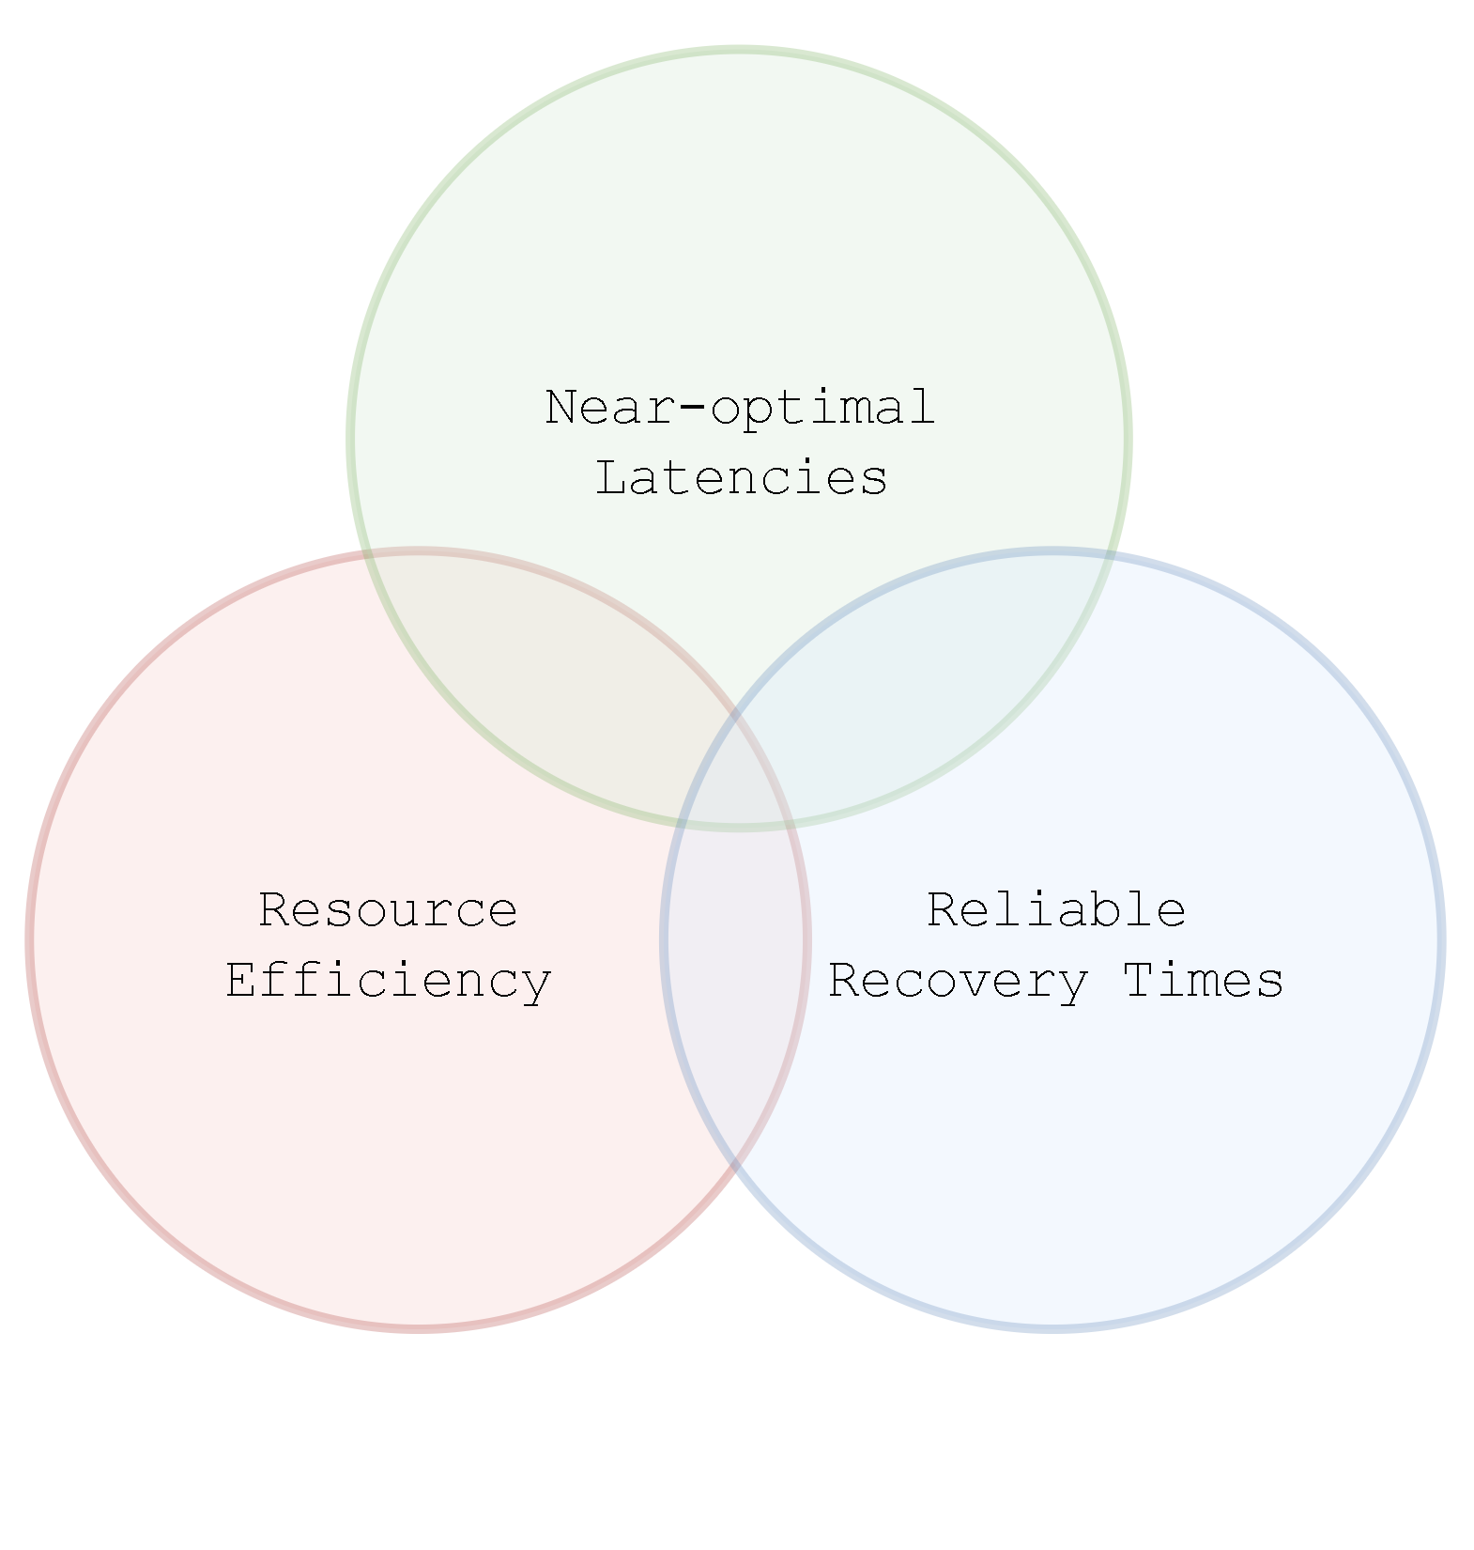
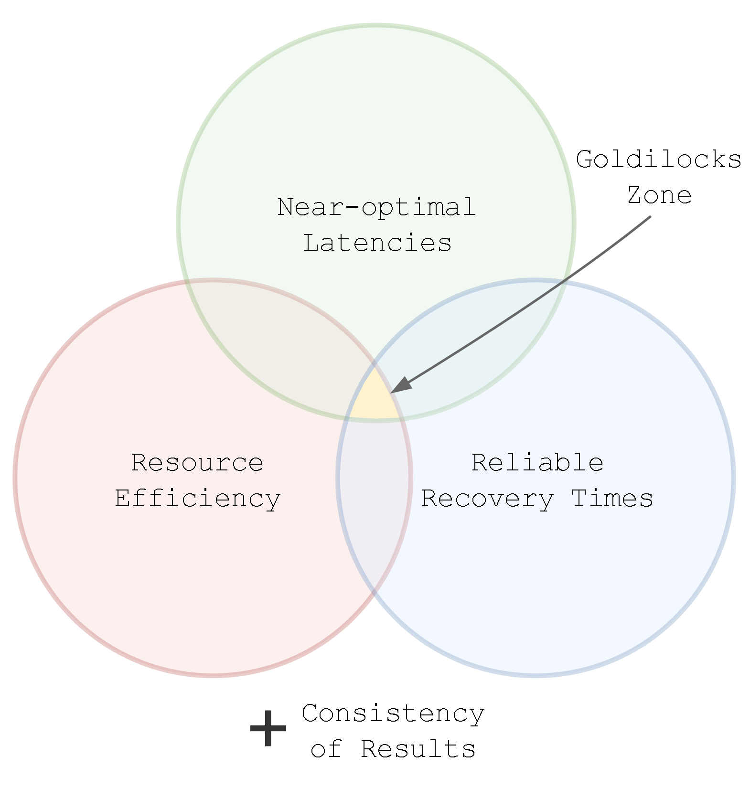
Problem:
DSP Operational Requirements

Slide 4
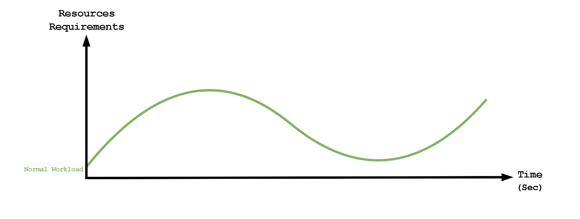
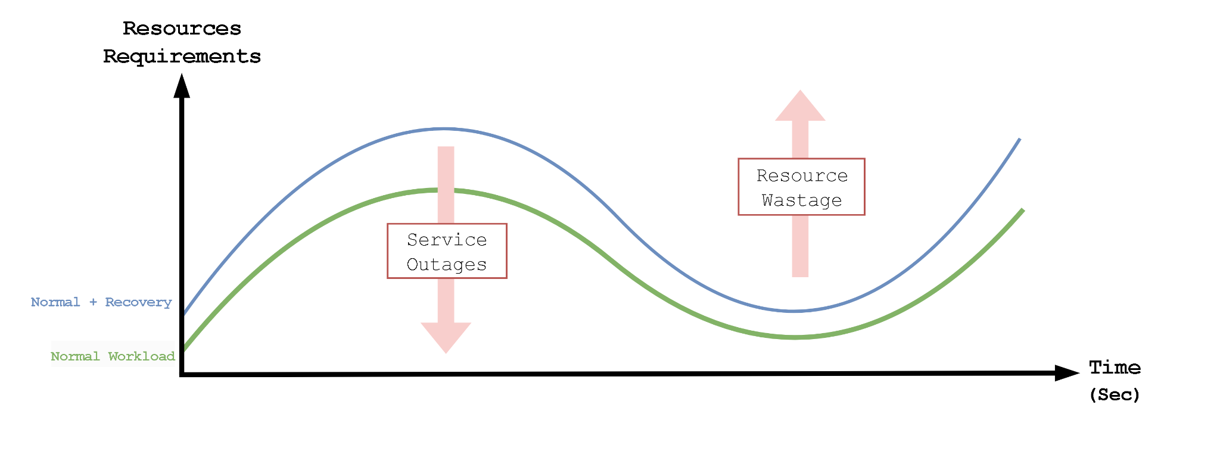
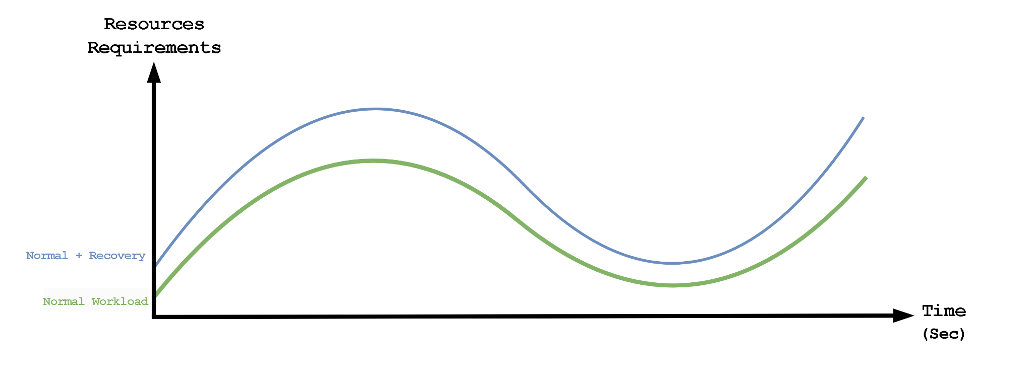
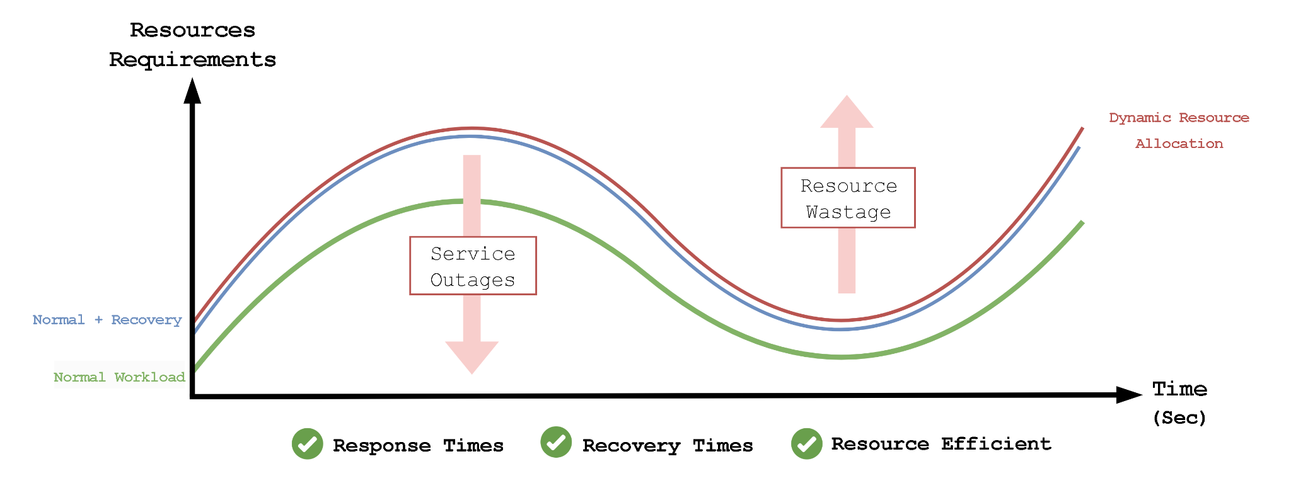
Solution:
Runtime Configuration Optimization
Dynamically match the resource requirements to the changing workload rate through runtime configuration optimization
Notes:
Reconfigurations are expensive as they cause disruptions to the service,
therefore we want to ensure changes are as long-lived as possible.

Slide 5
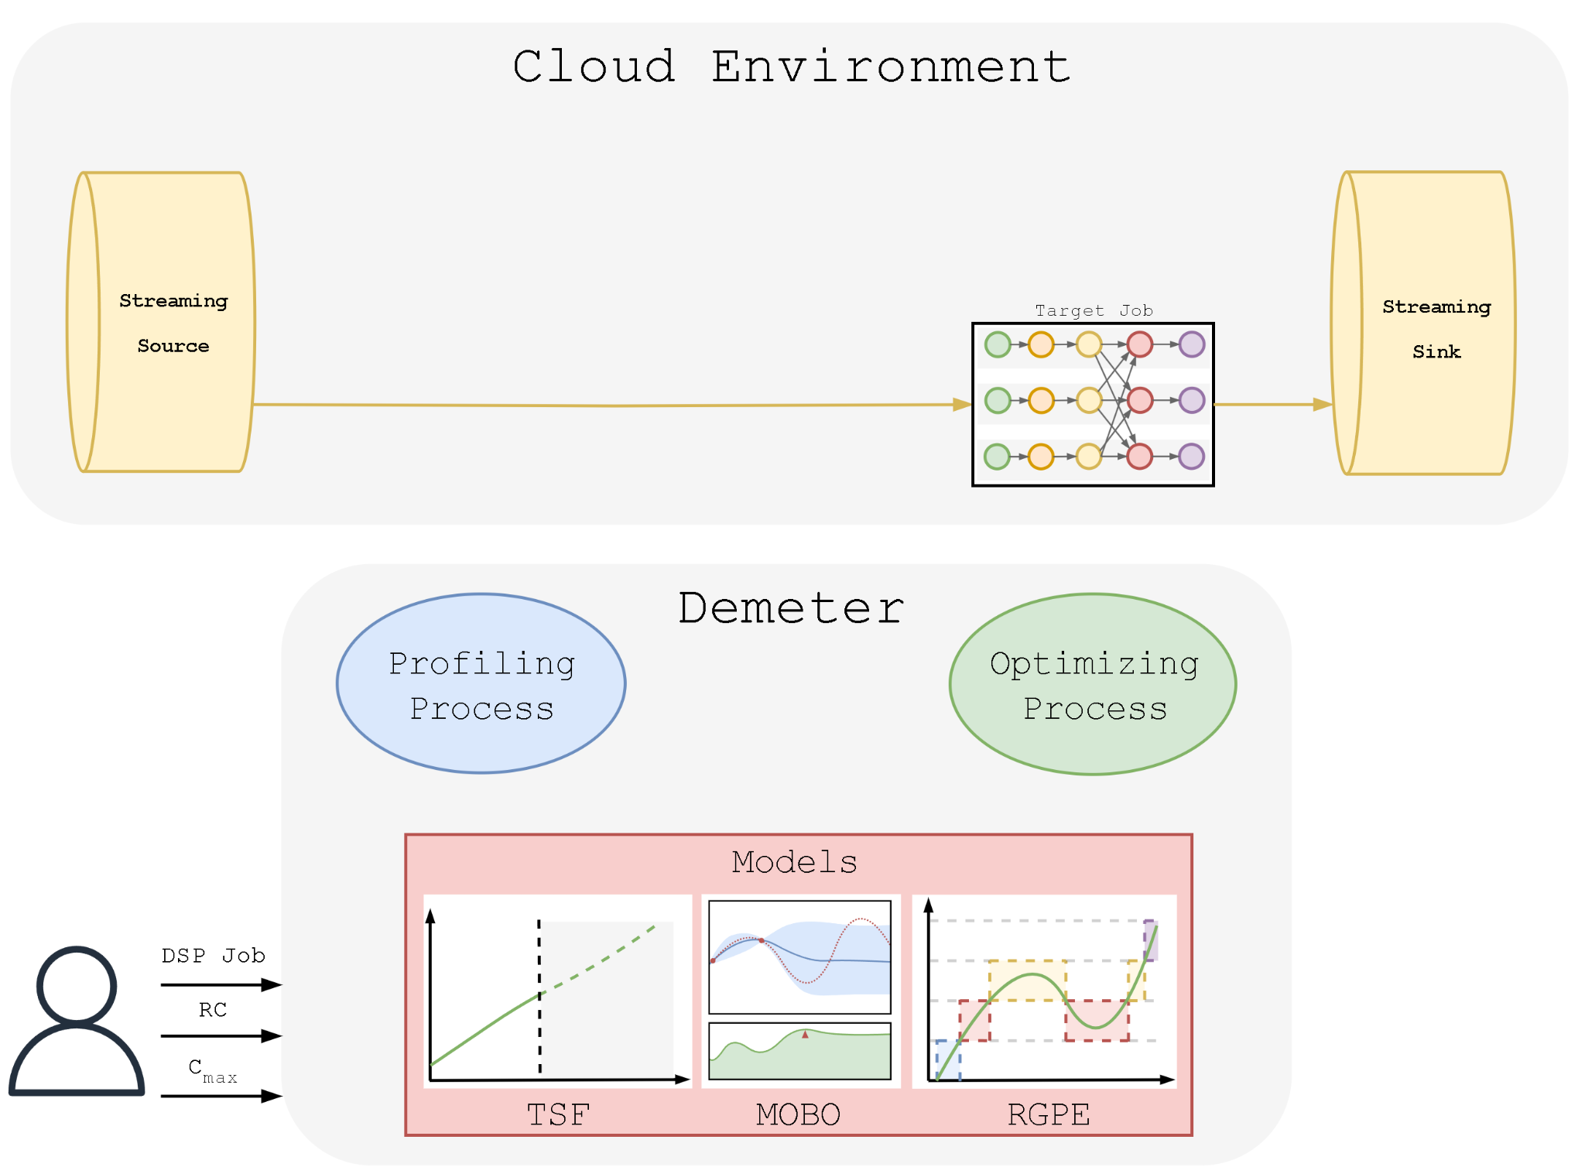
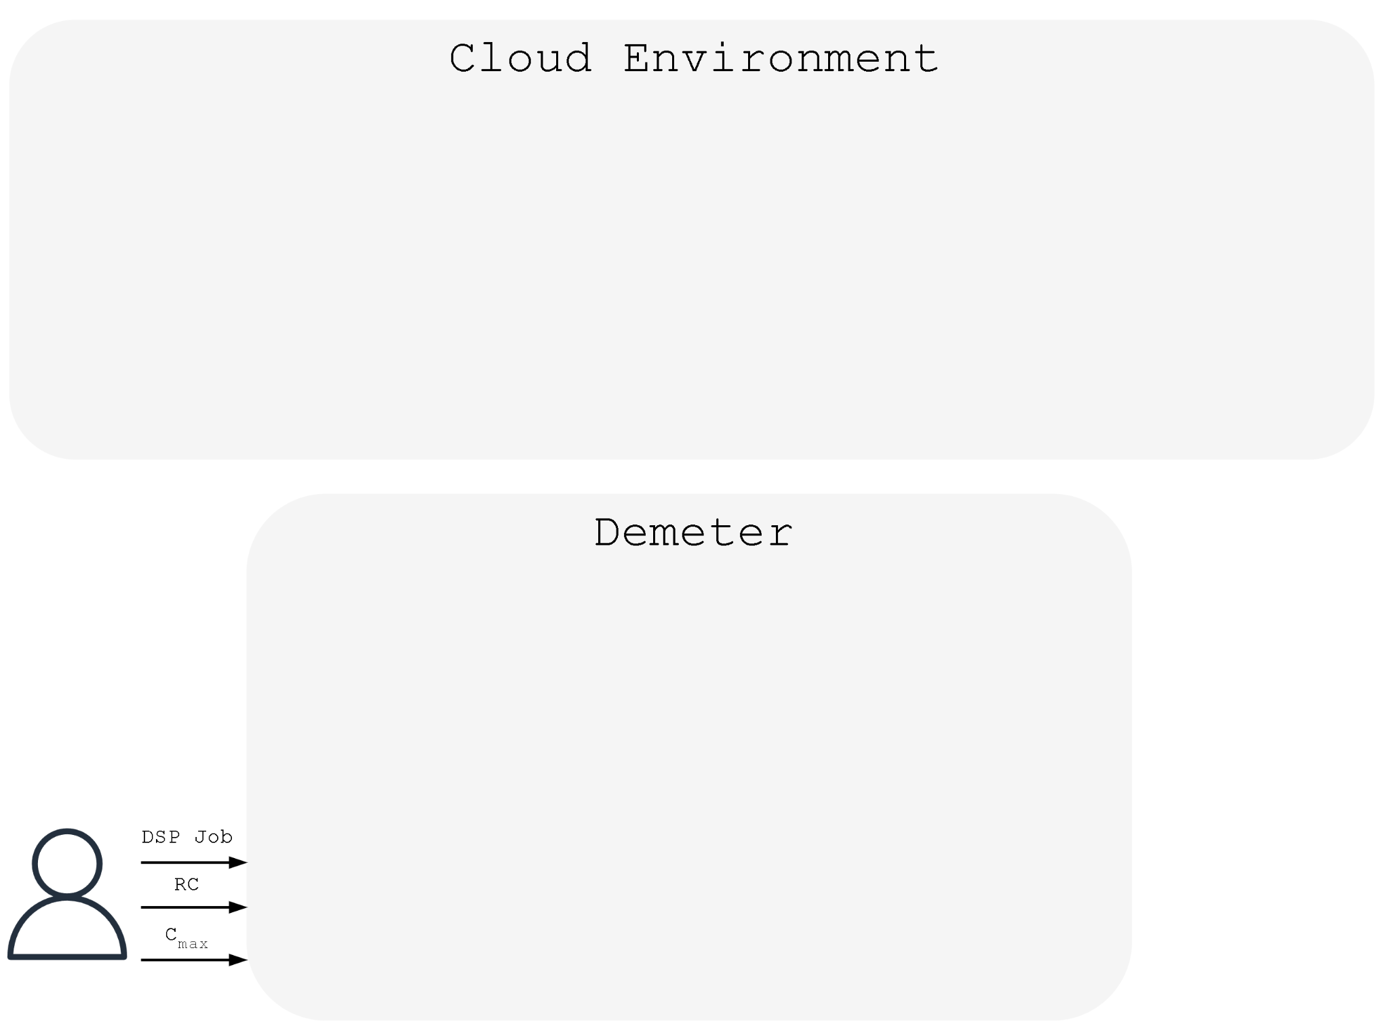
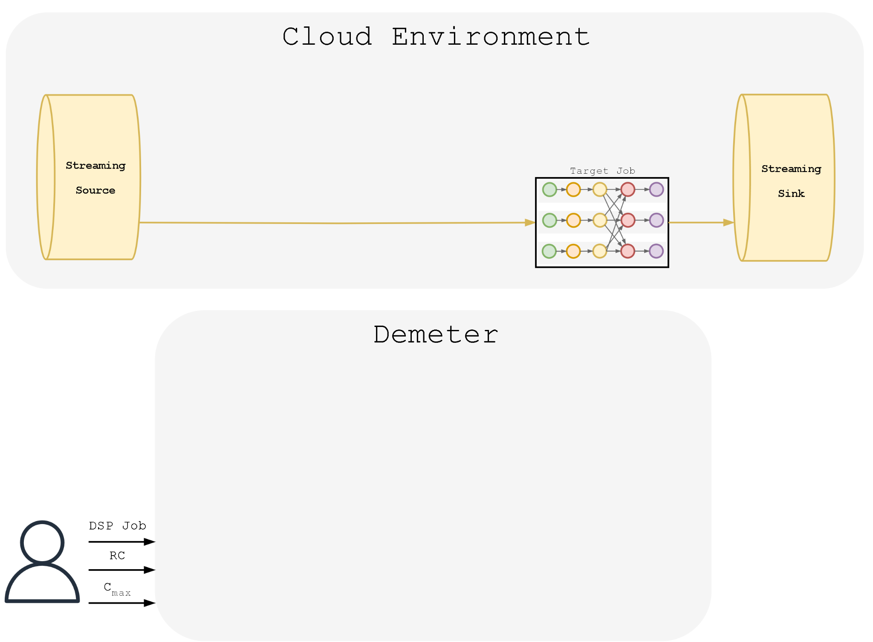
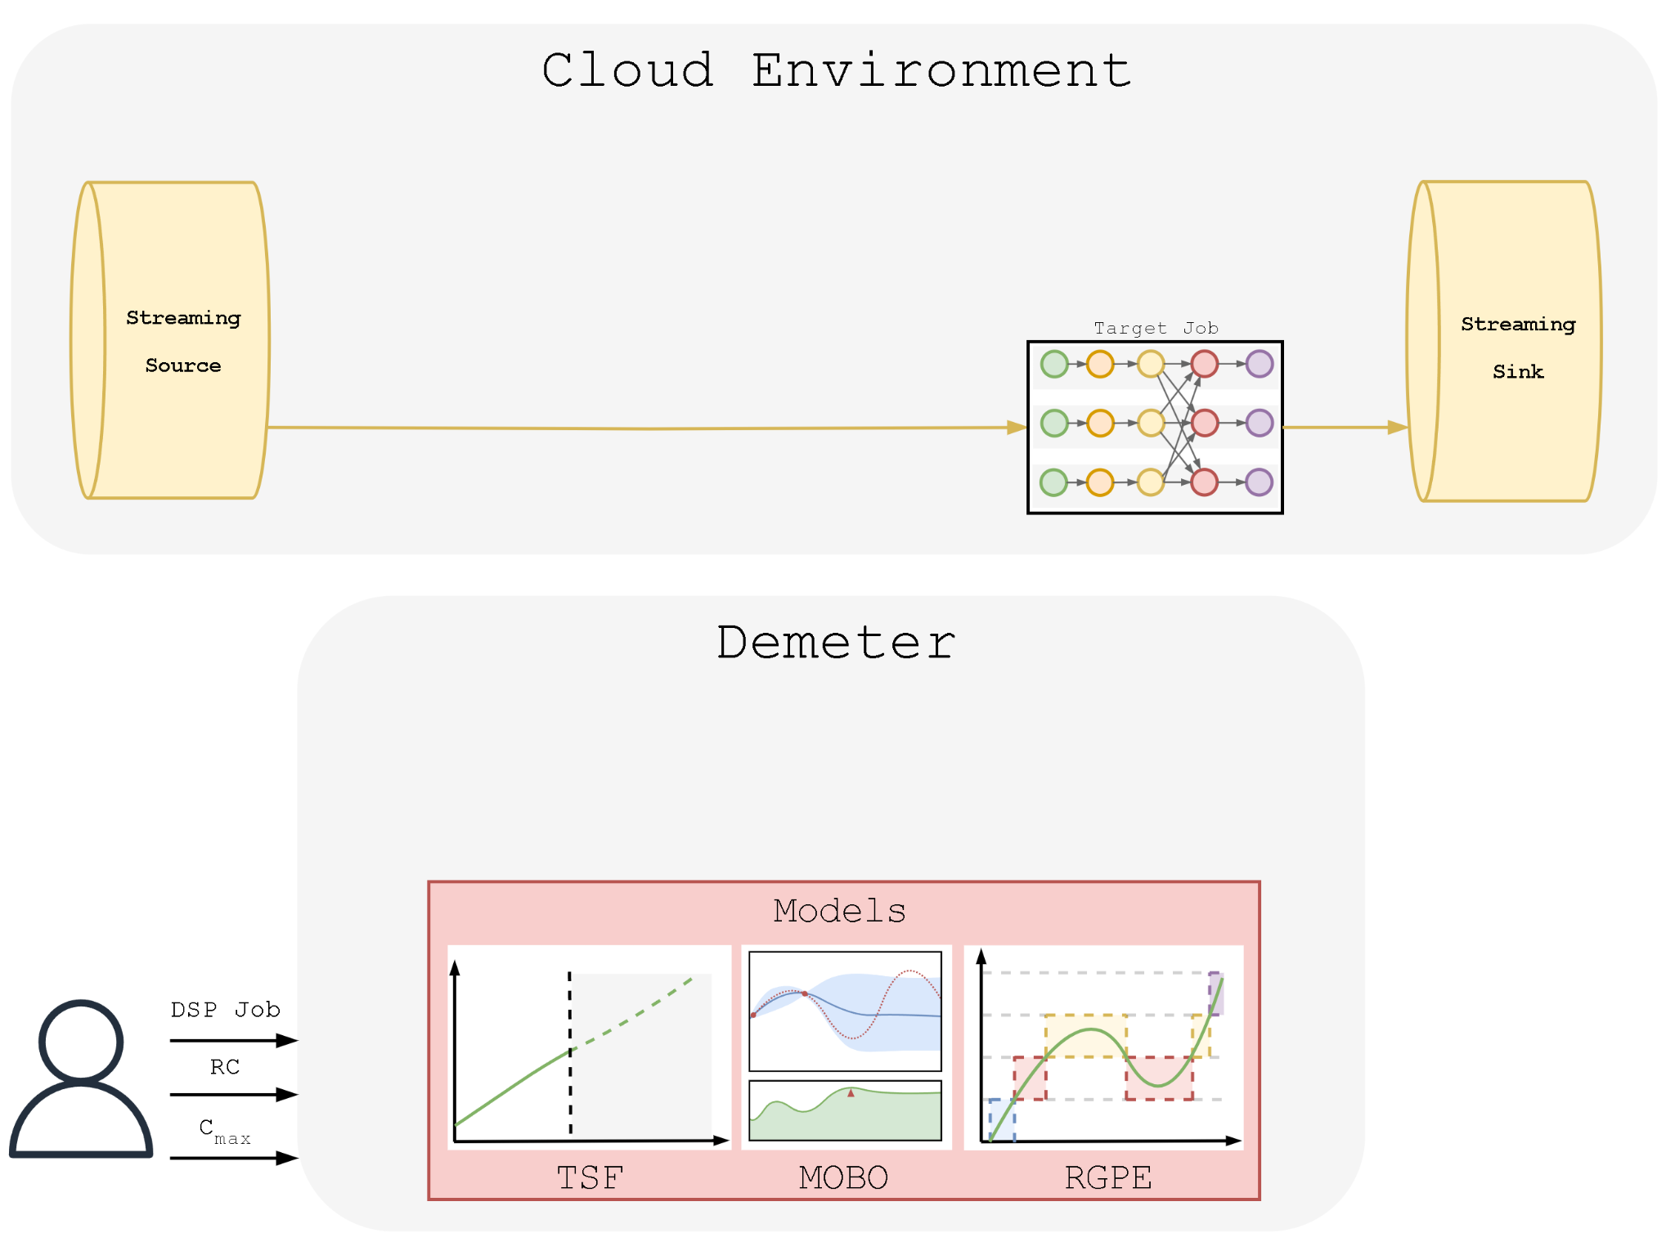
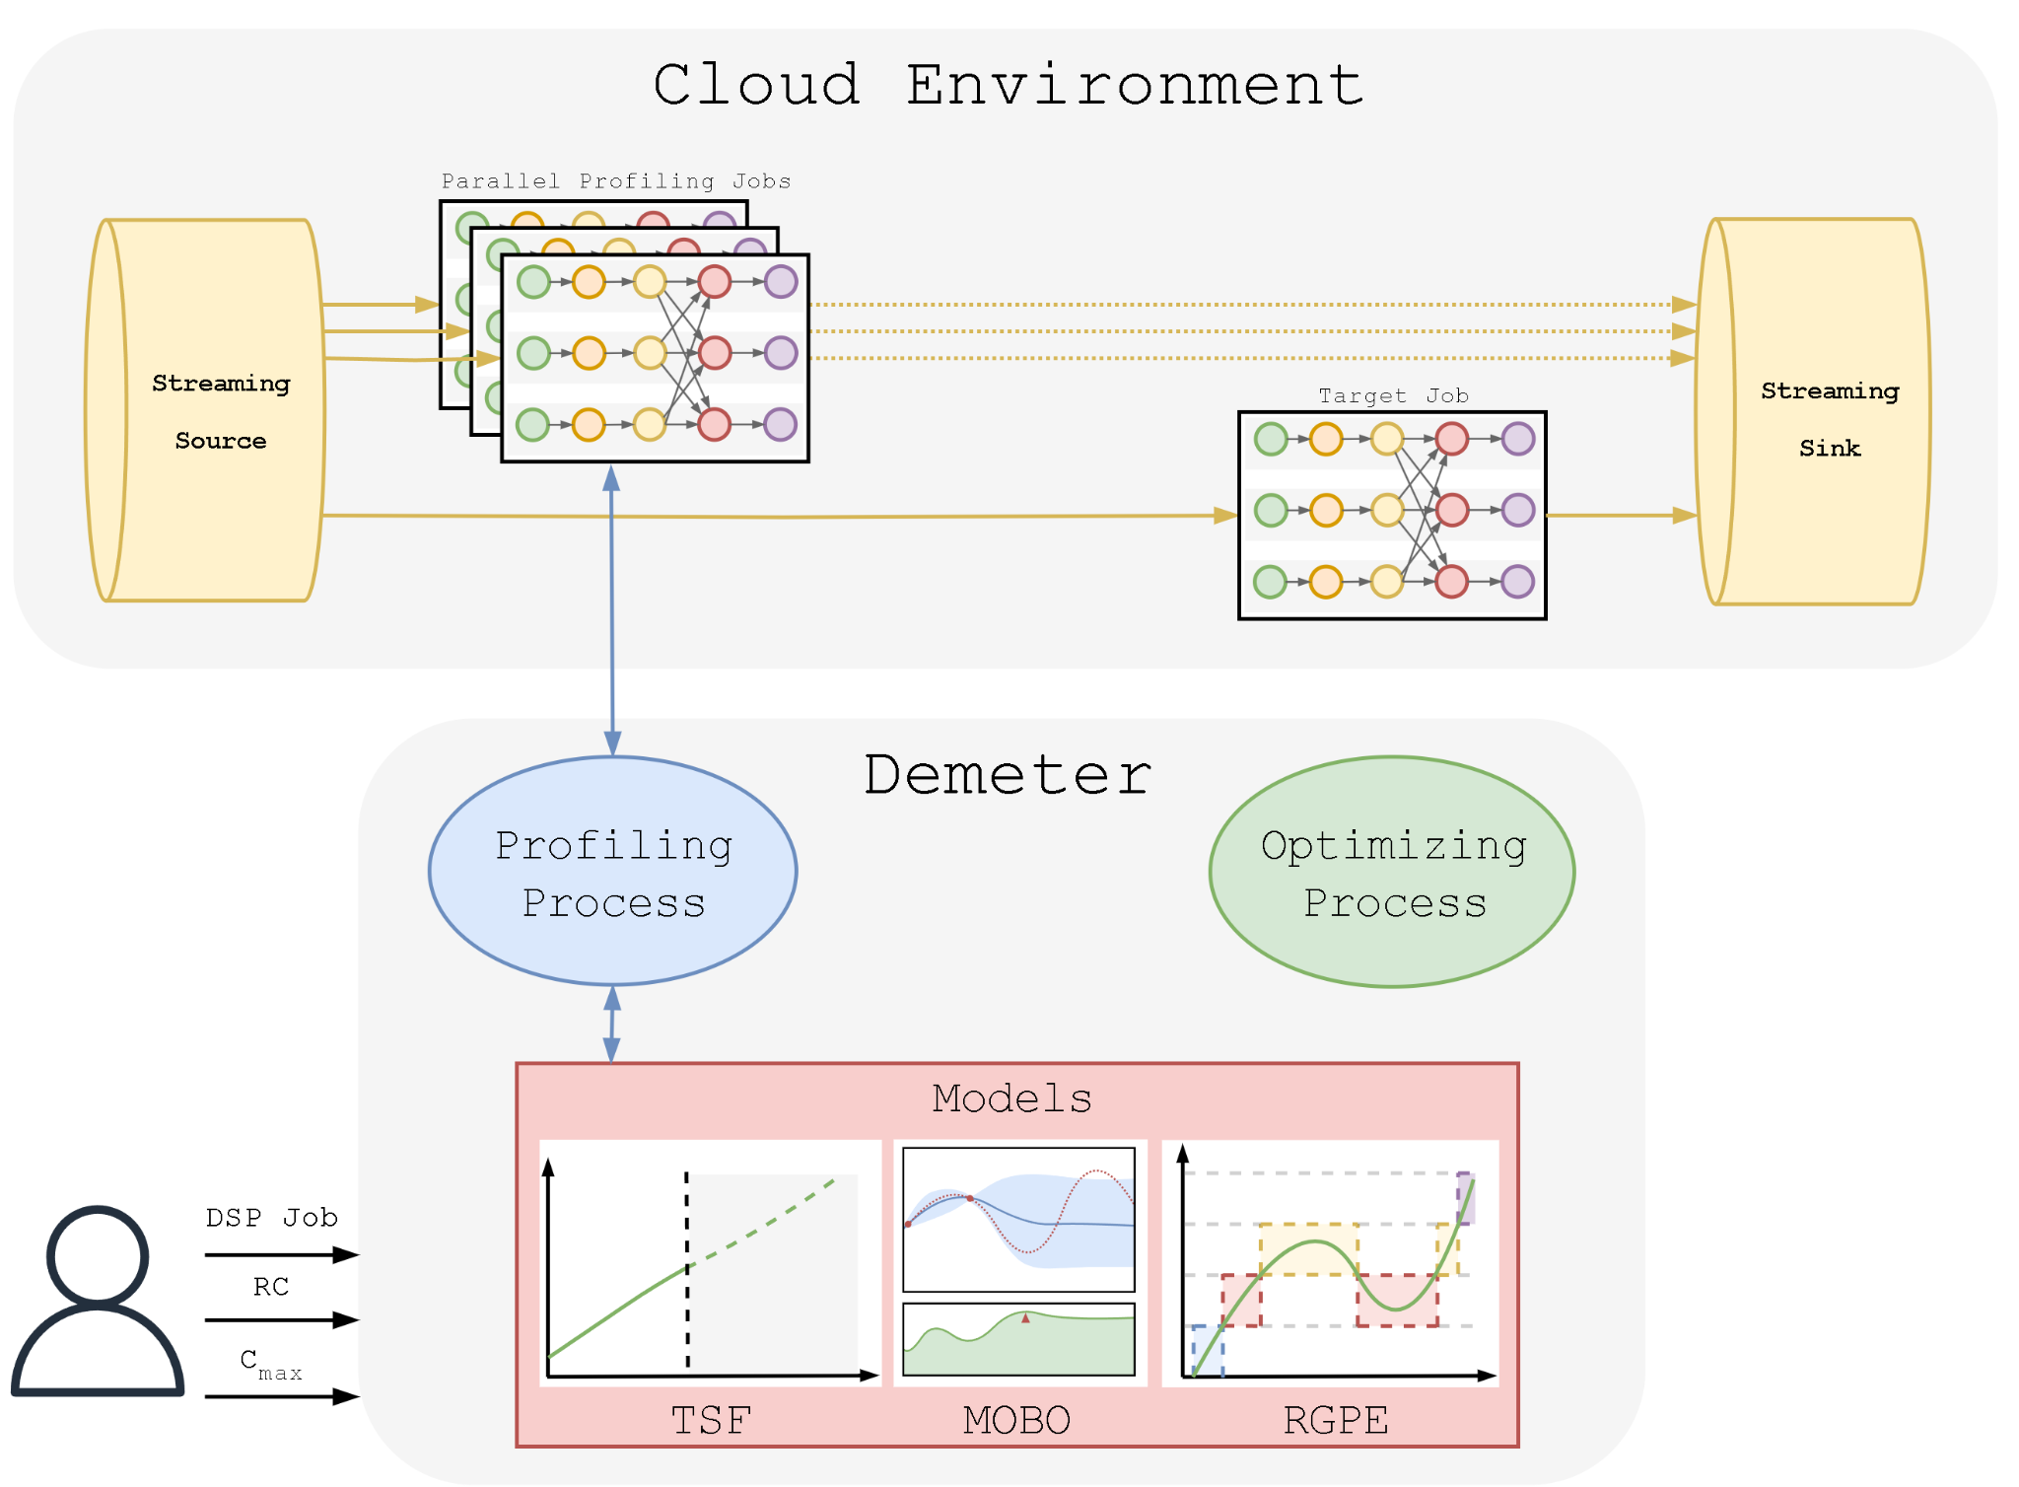

Approach:
Demeter High-Level Overview
Notes:
Two modeling approaches:
Multi-step time series forecasting: This gives us the “proactive” part of our approach. Instead of waiting for the system to fall into an inconsistent state and then react, we use the historical workload rate as input to predict what the workload rate is most likely to be at a particular time horizon. For us, this time horizon is about 10 minutes. So using this we can preemptively take actions about what is to come.
Multi-objective bayesian optimization: This allows us to model the behaviors of the configuration parameters of the DSP system at particular workload rates, where the objective function is the performance metrics “end-to-end latencies” and “recovery times”. Bayesian optimization give us the ability to efficiently explore a search space through sampling, so it uses an acquisition function which guides where to amke the next observation to decrease uncertainty.
An this is quite useful because we follow a profiling

Slide 6
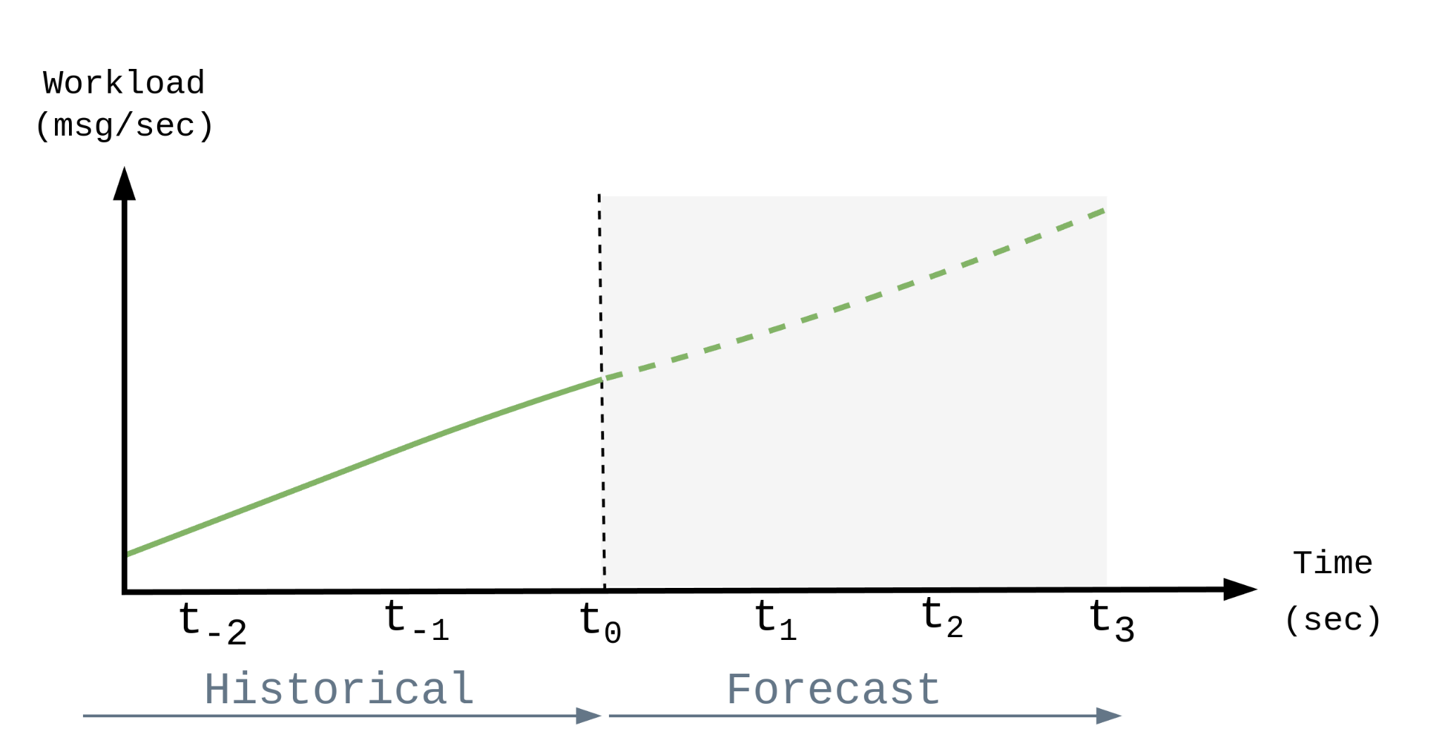
Approach:
Modeling Techniques
Multi-Step Ahead Time Series Forecasting (TSF)

Slide 7
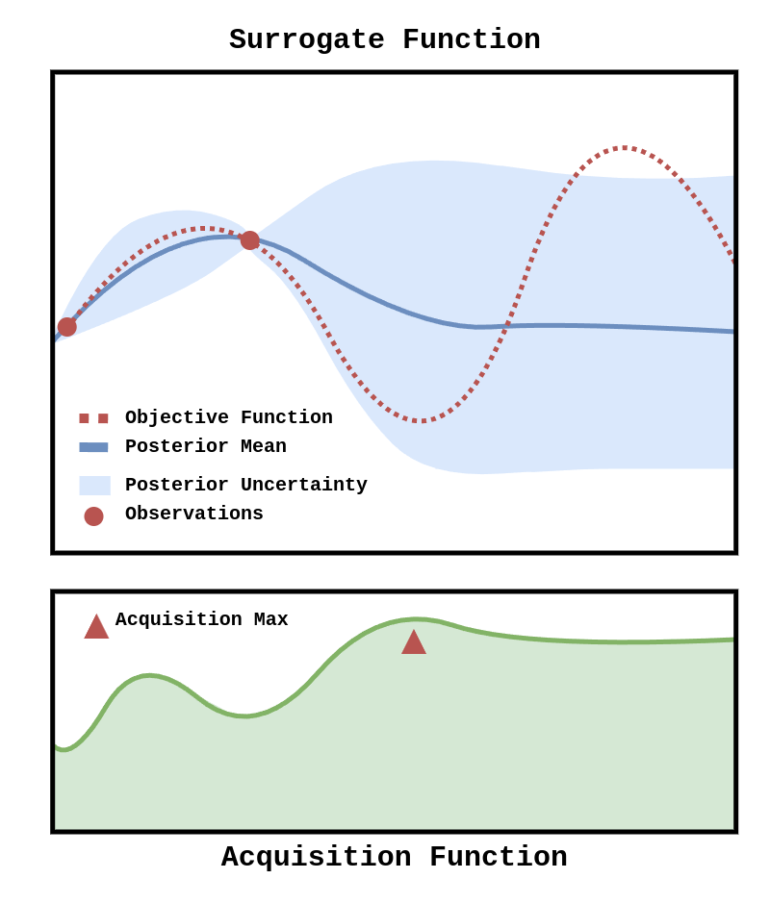
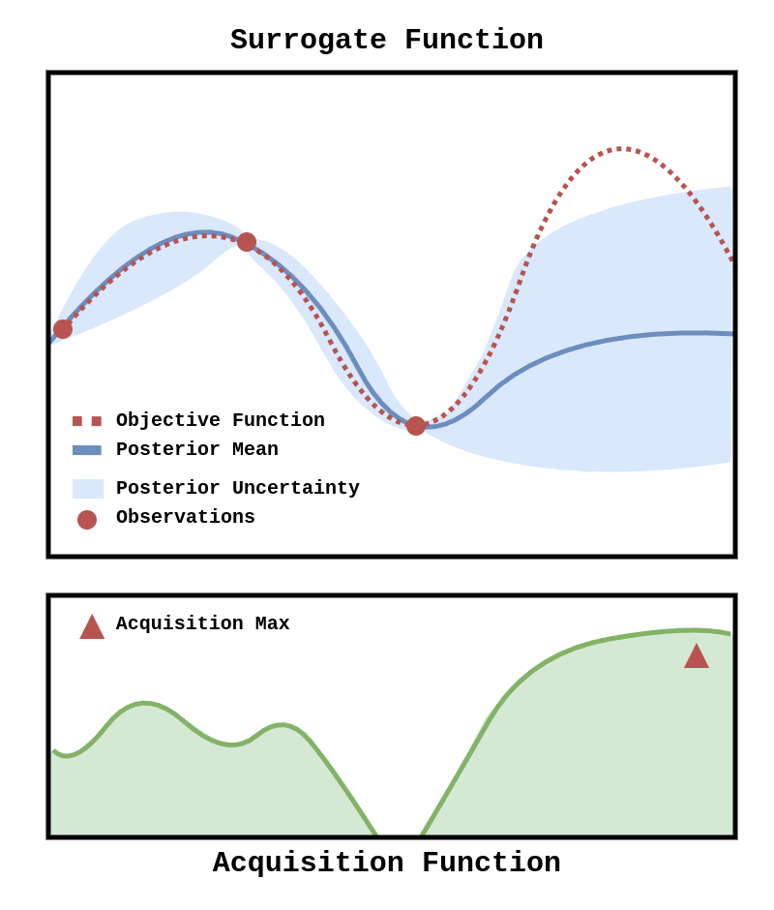
Approach:
Bayesian Optimization
Multi-Objective Bayesian Optimization (MOBO)
Notes:
Secondly, In our approach to optimizing system configurations, we use Multi-Objective Bayesian Optimization, where the key performance metrics latency and recovery time are our main focus. Each metric and constraint within our system is represented through a specific Gaussian process model. These models serve as our surrogate functions, providing a predictive framework based on the various configuration parameters.
Here's how it works:
Objective Function: This function defines what we are aiming to optimize. In our case, it's the system's performance metrics like latency and recovery time.
Surrogate Function: These are the Gaussian process models that estimate the outcomes of our objective function based on different configurations. They evolve and improve as we gather more data.
Posterior Uncertainty: Each surrogate function calculates not just the expected outcome but also the uncertainty of that prediction. This uncertainty helps us understand where more information could reduce risks and improve decision-making.
Acquisition Function: Guided by the uncertainty and predictions from the surrogate functions, the acquisition function directs us where to next sample the configuration space. It helps identify the most promising configurations to test next, optimizing our exploration and exploitation of the search space.
This structured approach enables us to systematically refine our configurations, balancing performance improvements with operational feasibility. It’s particularly effective in environments with low variability, where our predictions and adjustments can be most precise.

Slide 8
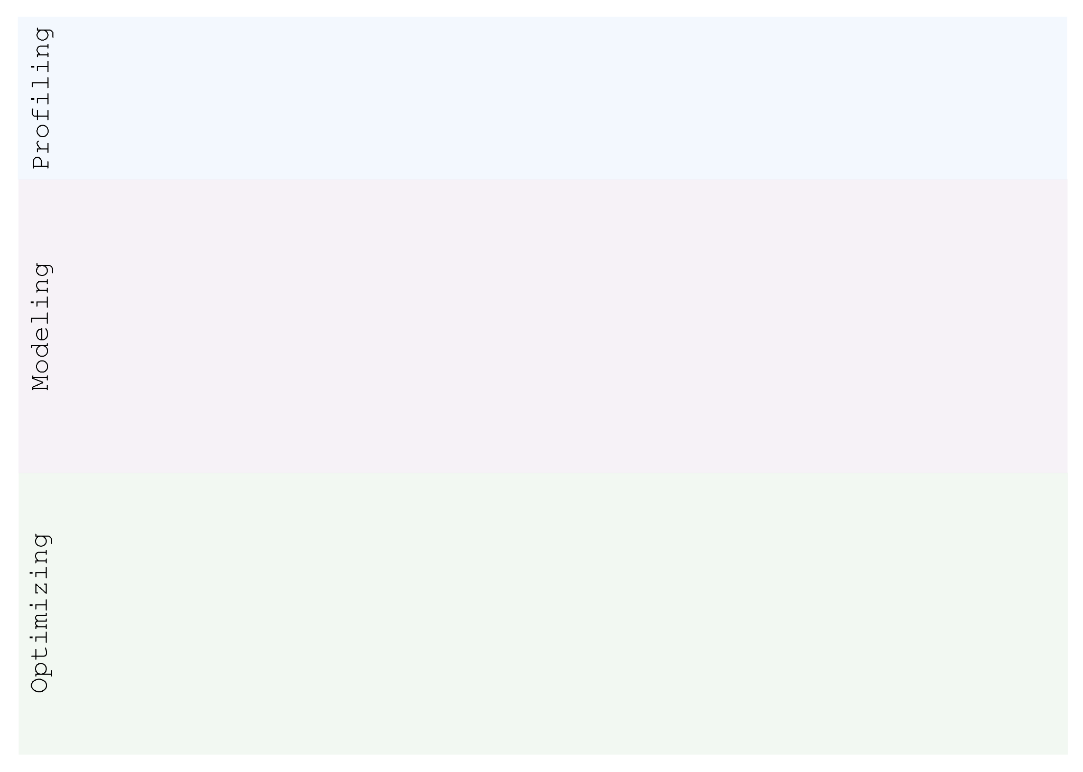
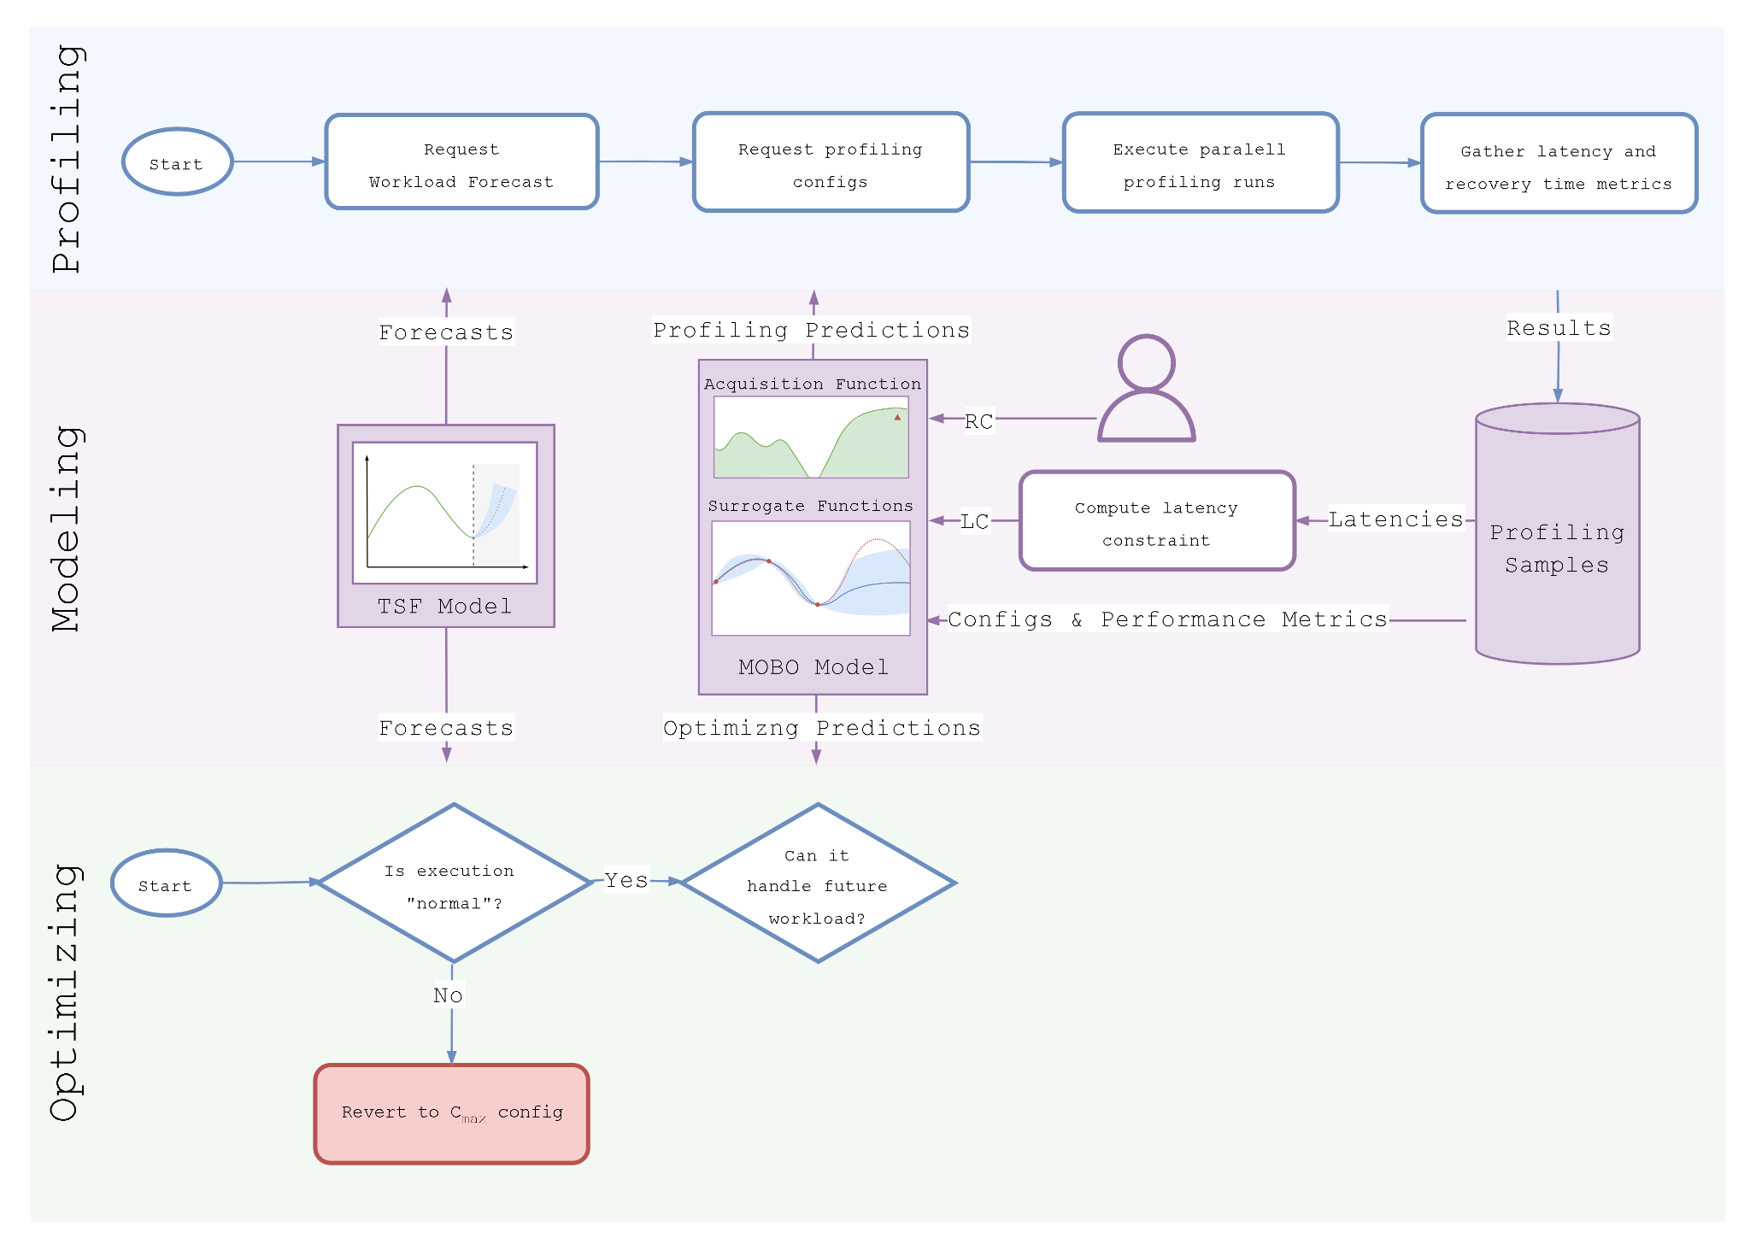
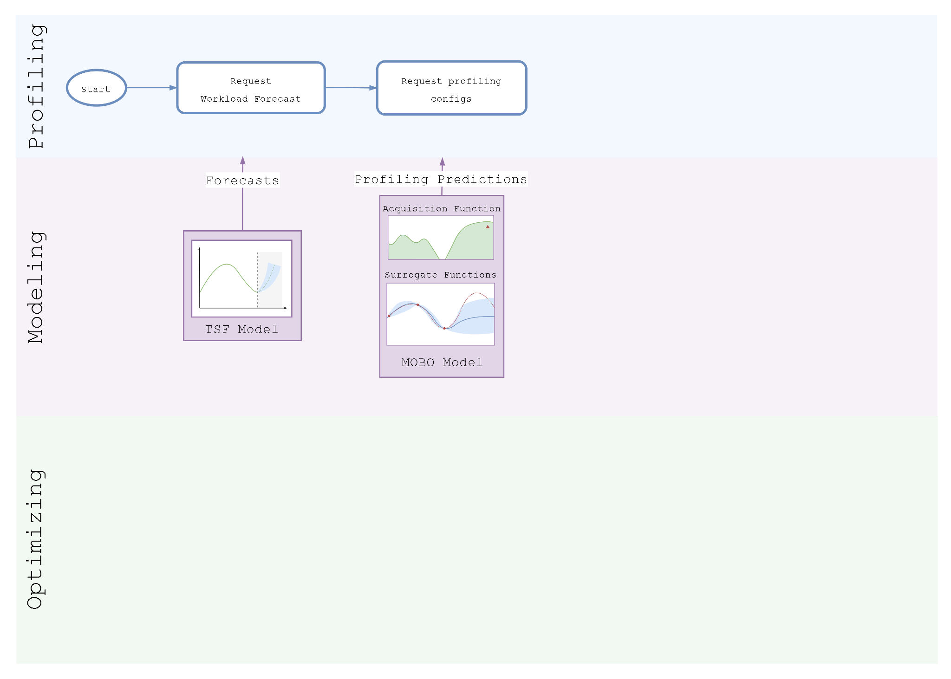
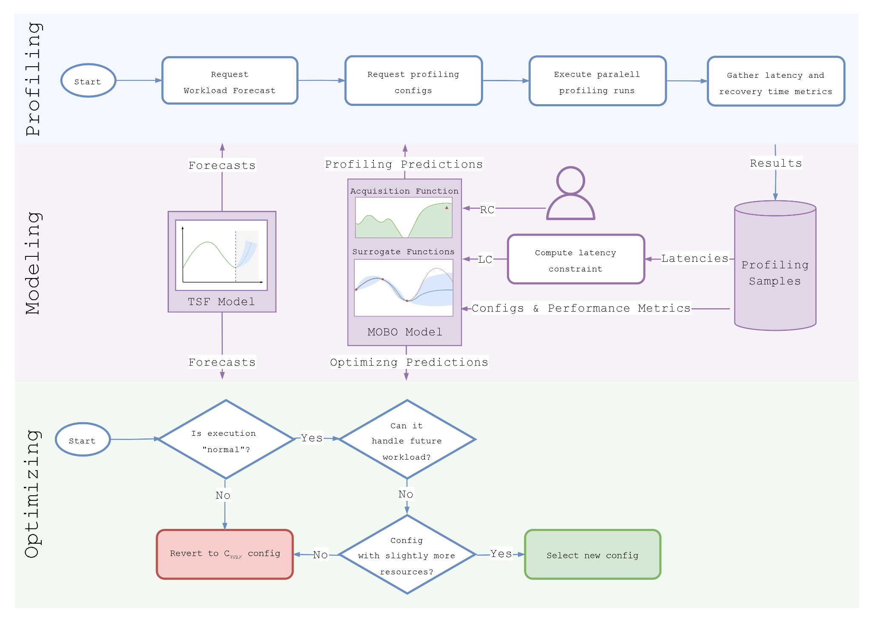
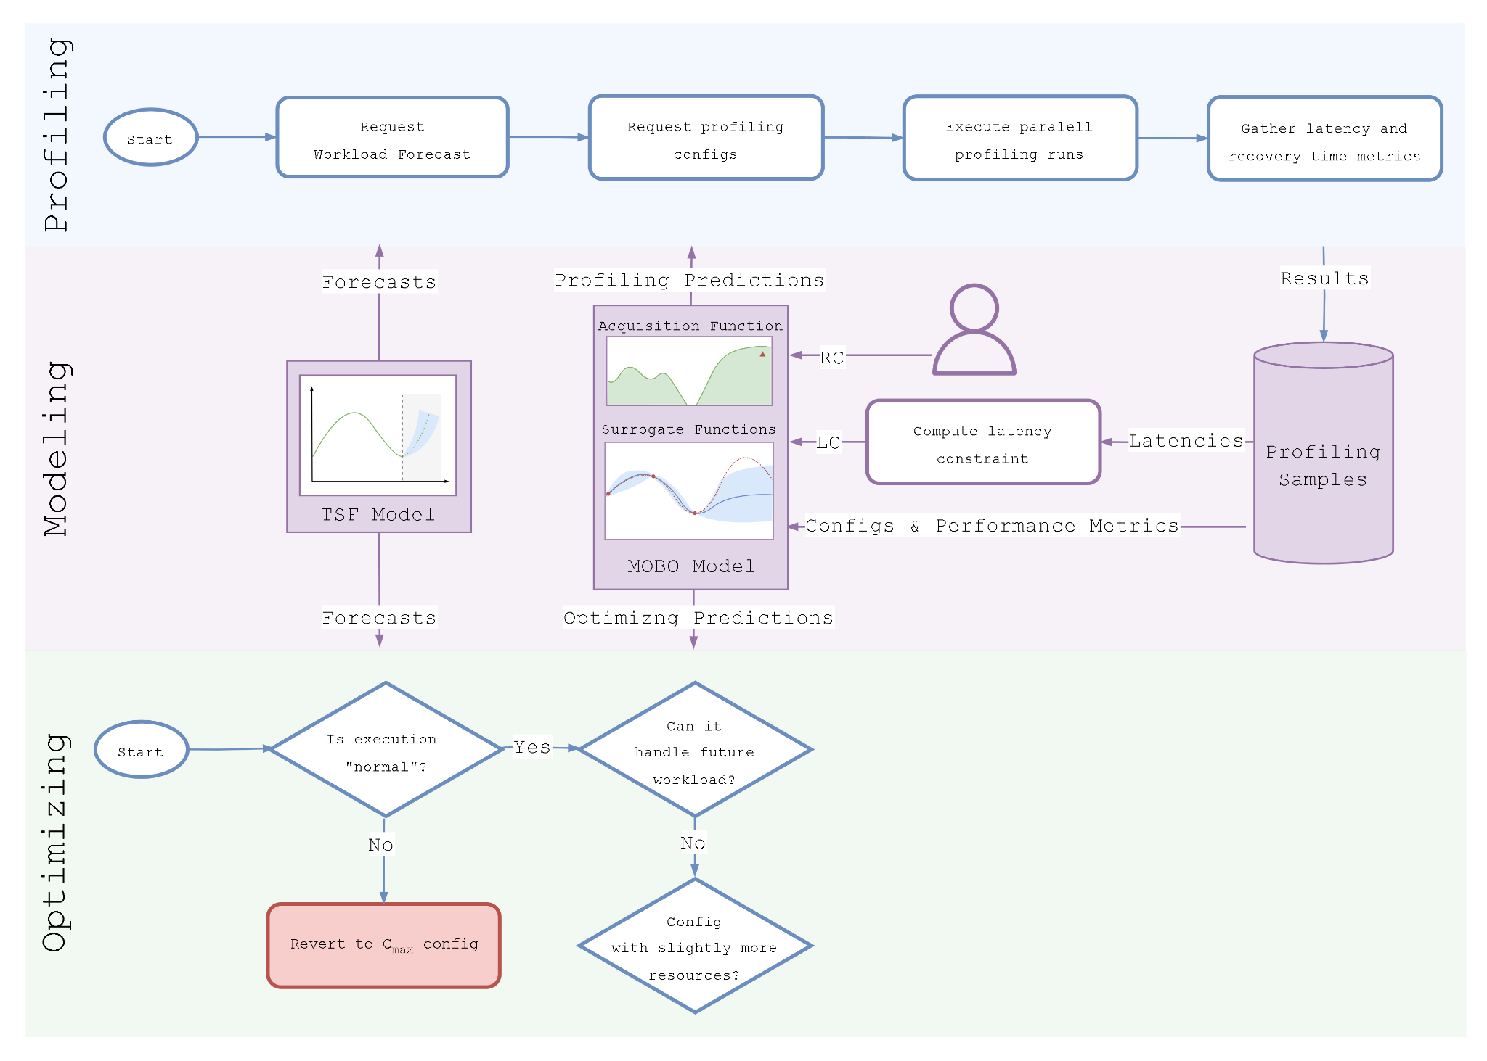
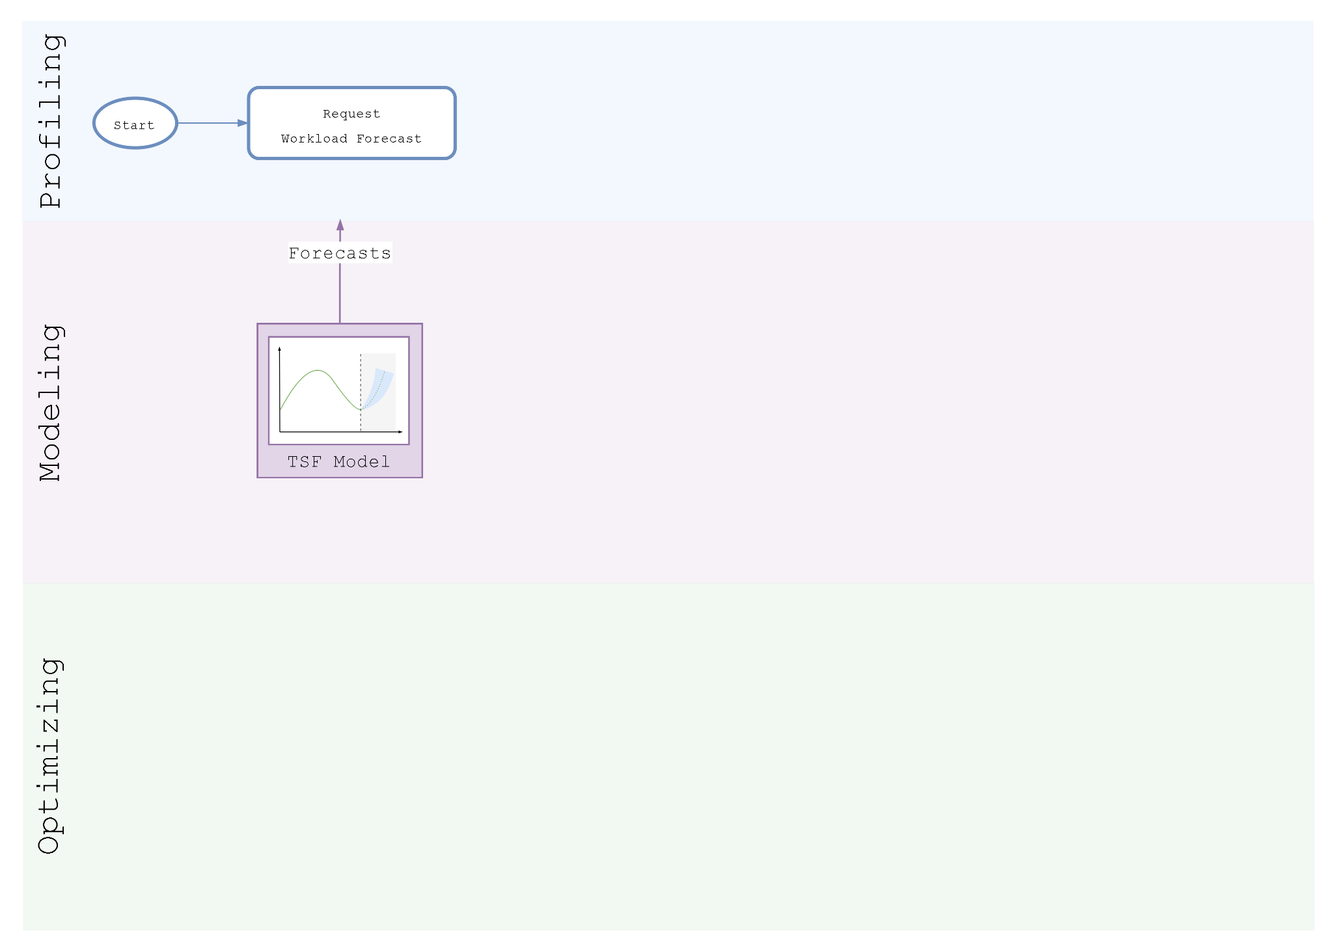
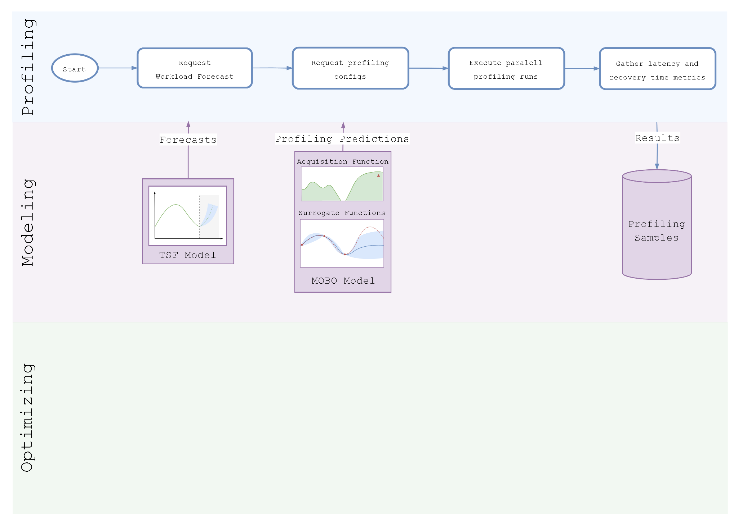
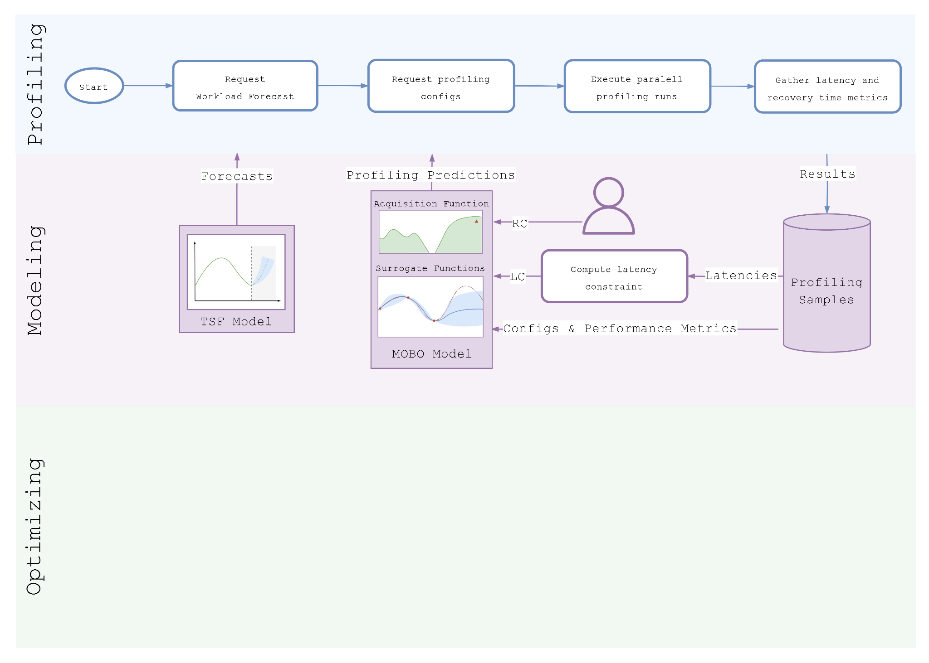
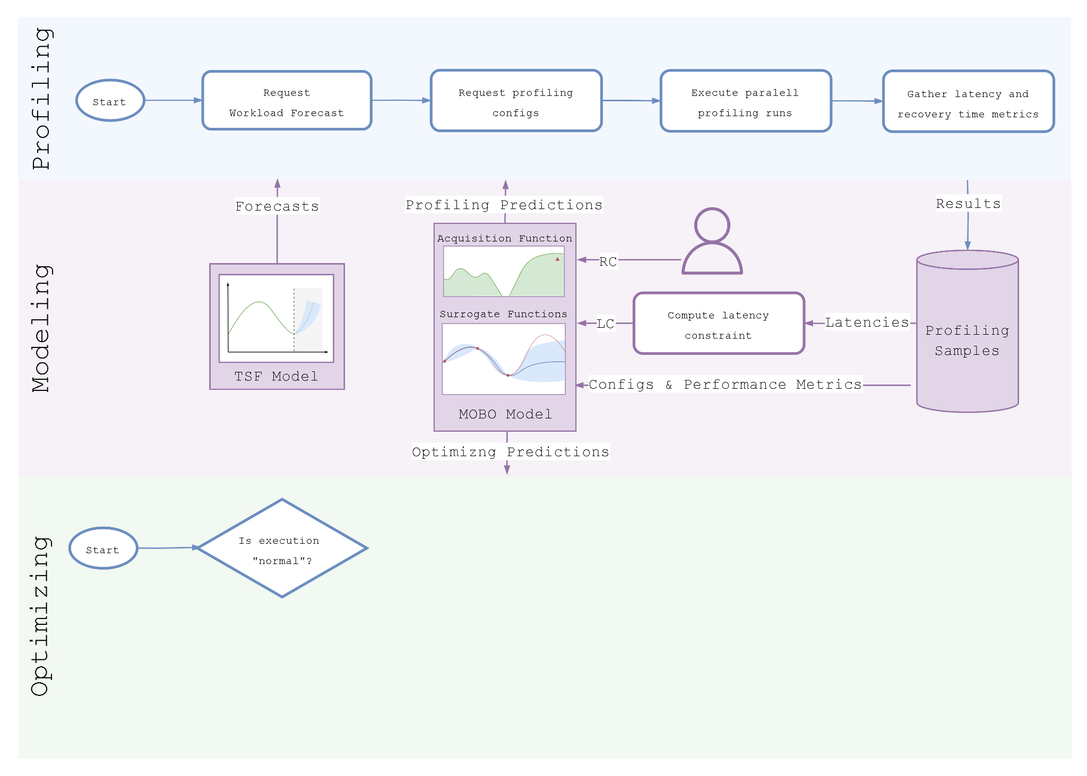
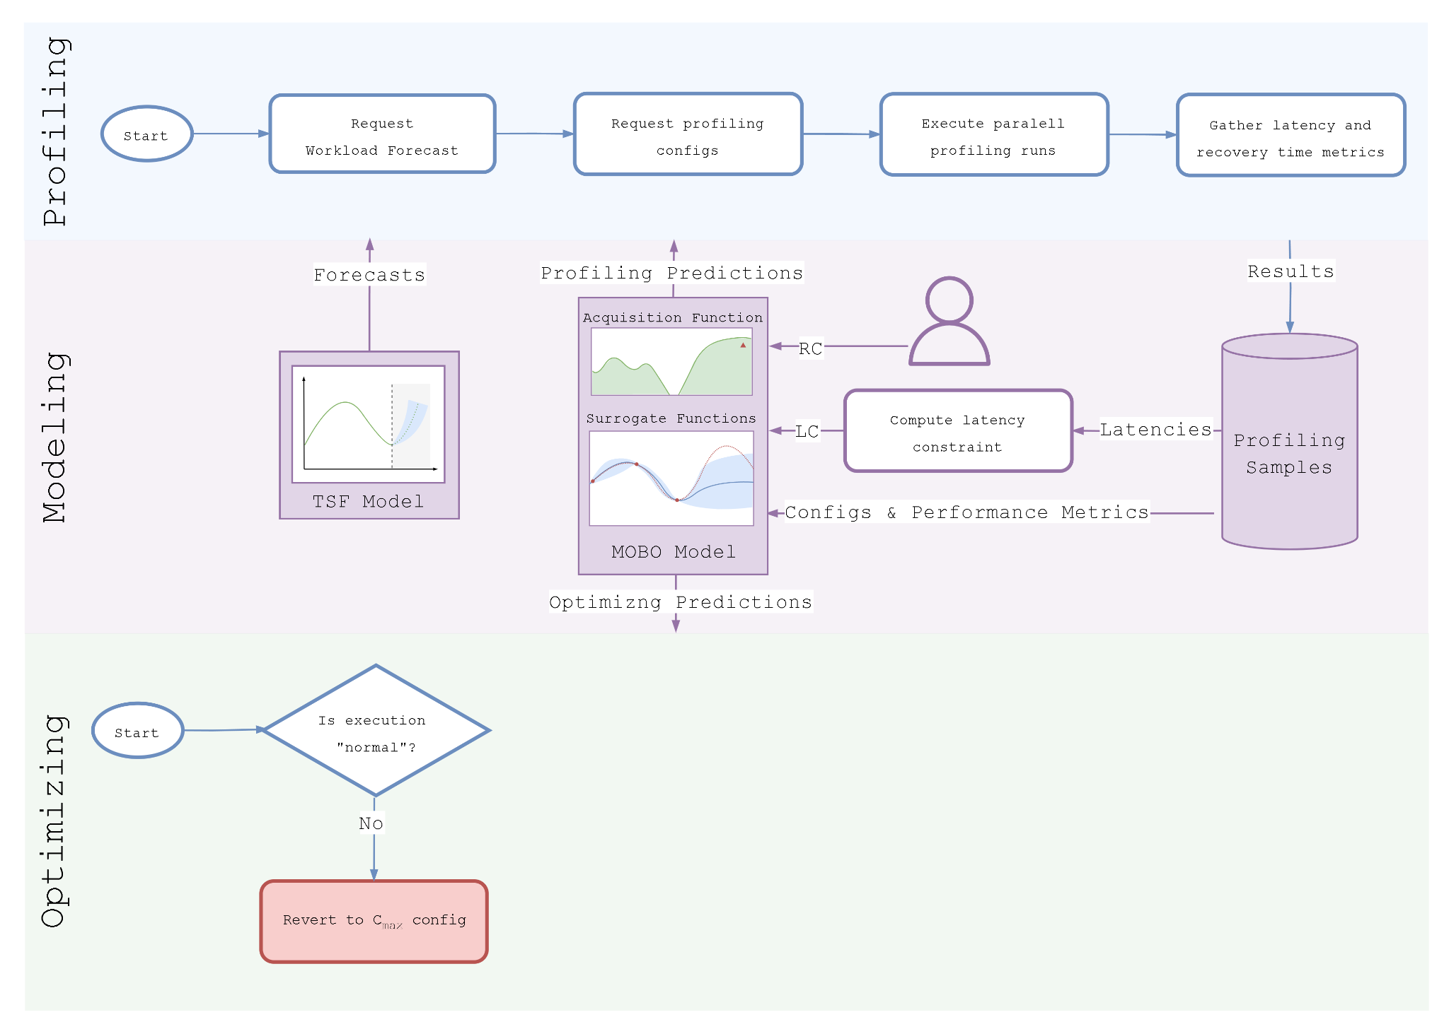
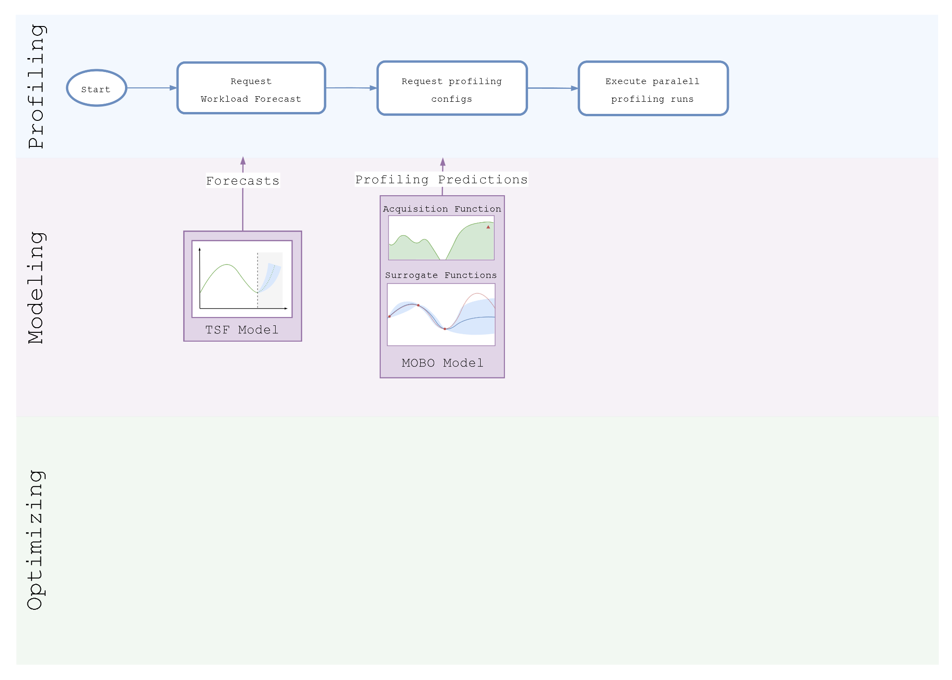

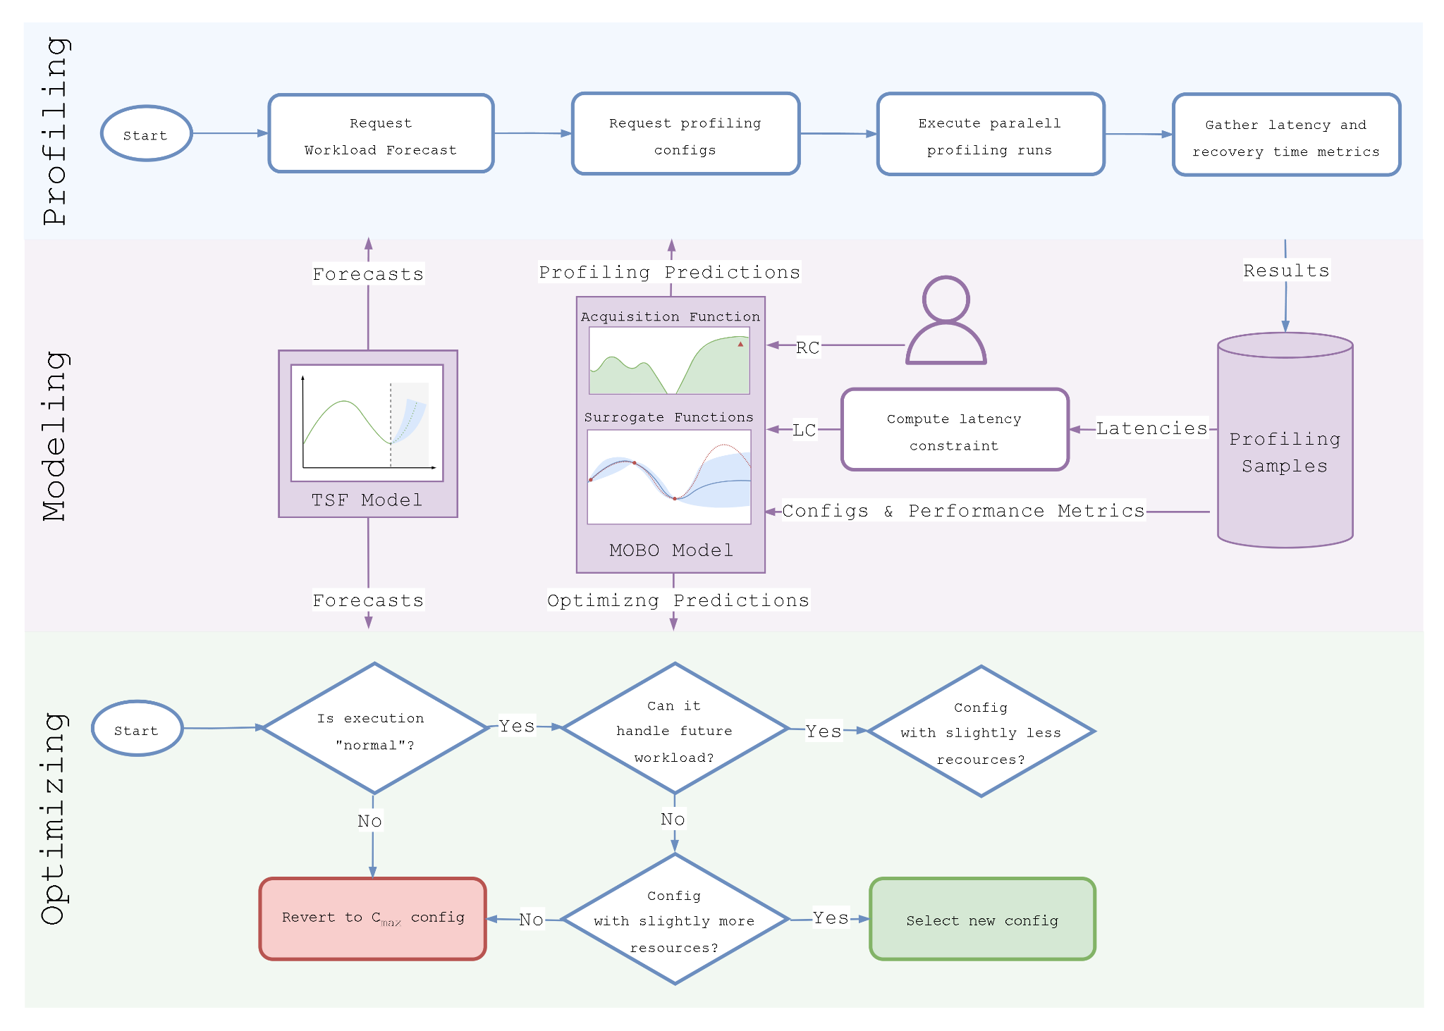
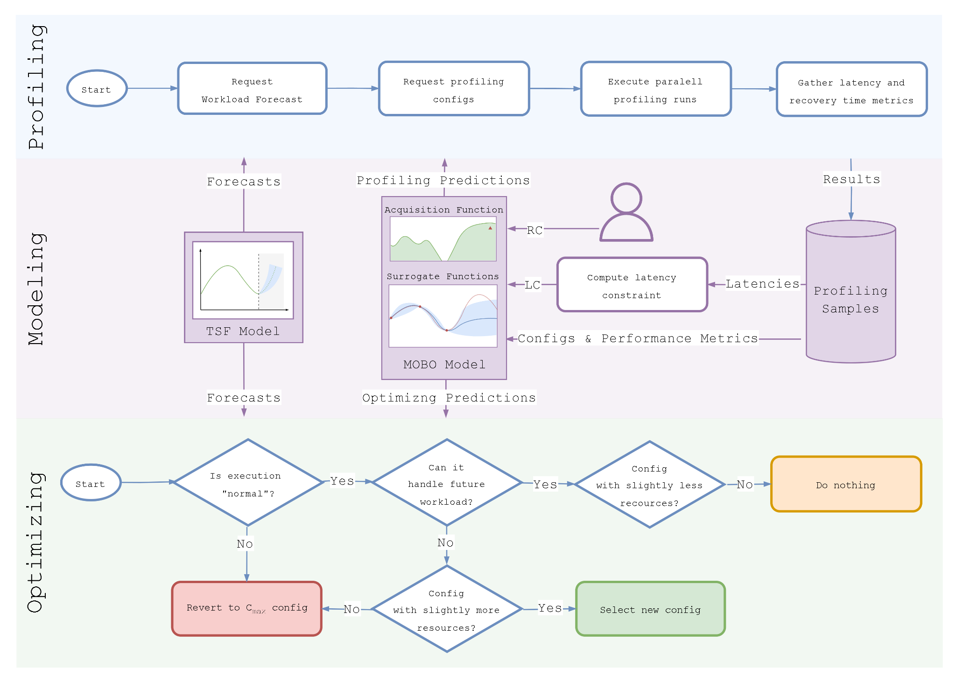

Approach:
Profiling & Optimizing Processes
Notes:
Acquisition Function: Provide set of Configuration which are most like to Maximise the Expected Improvement

Slide 9
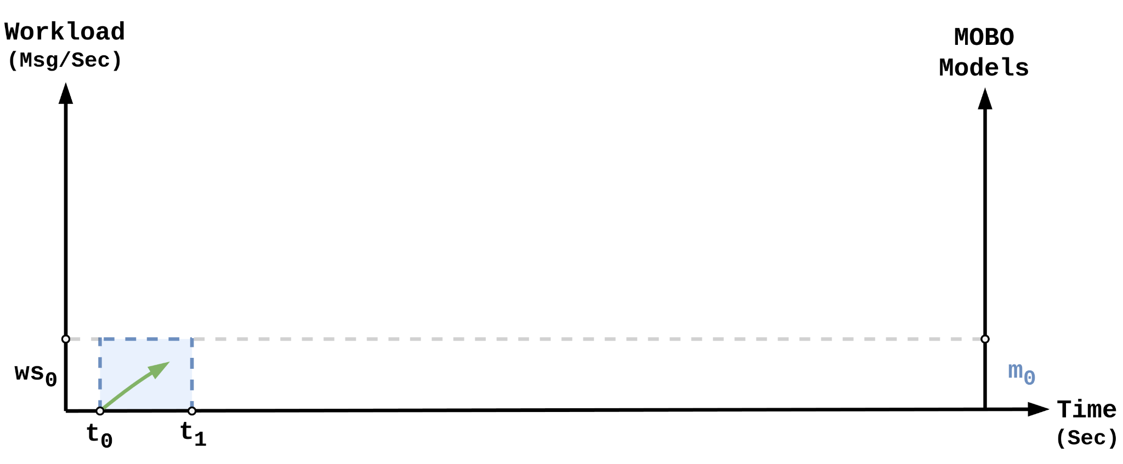
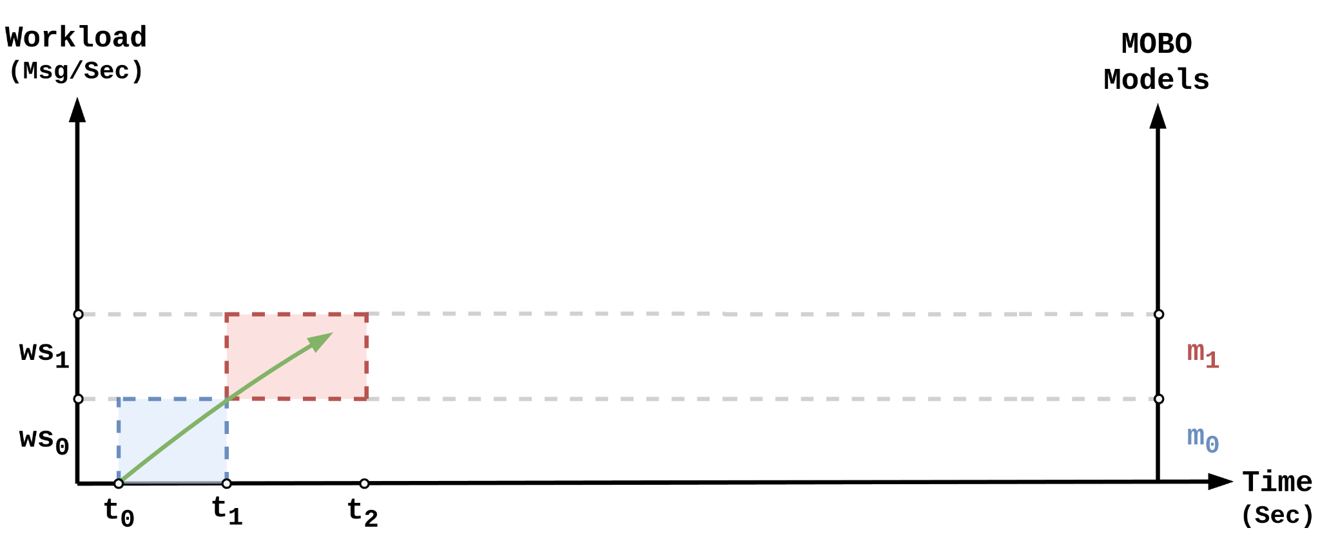
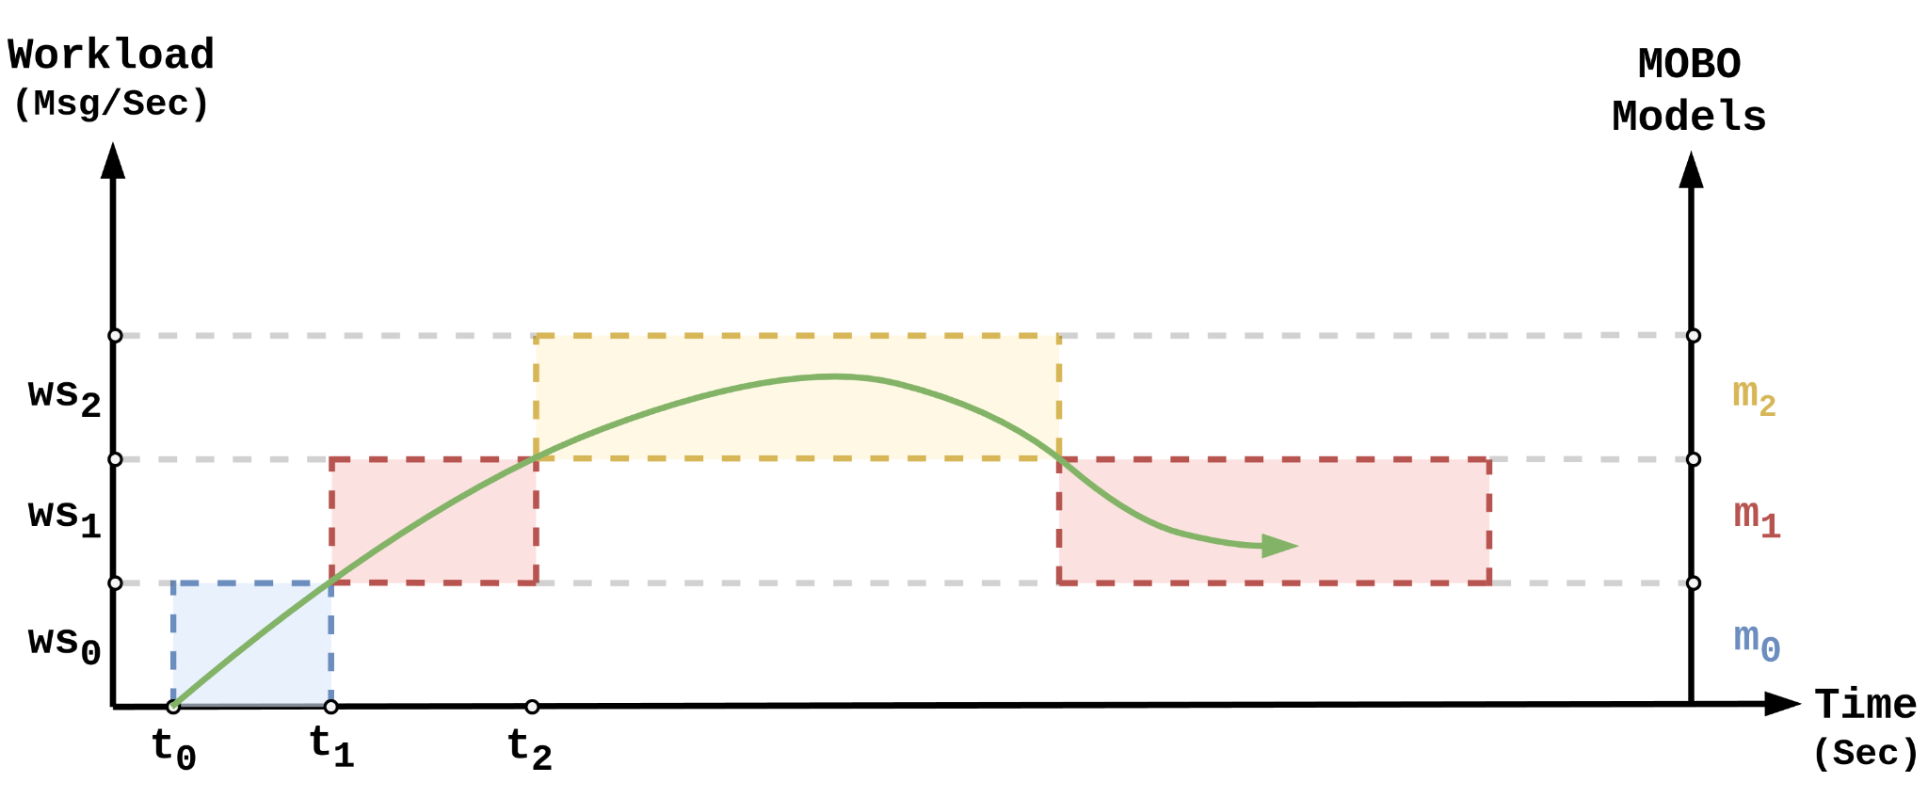
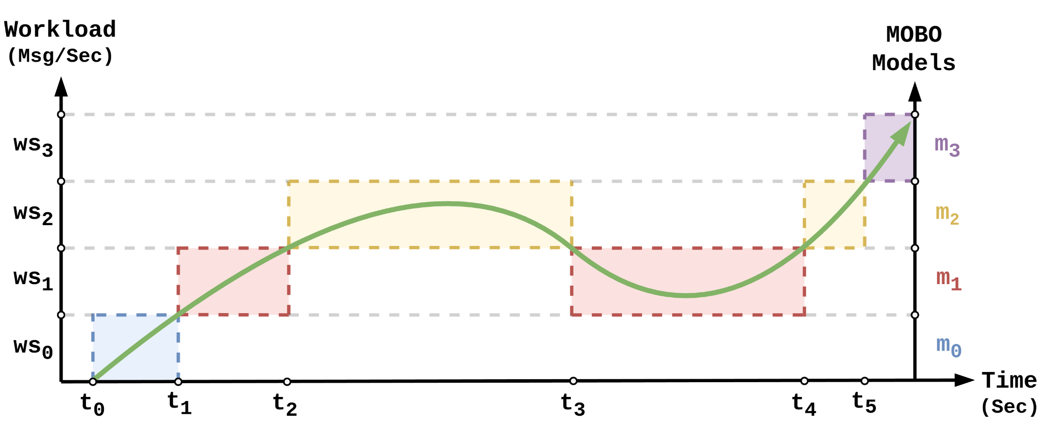
Approach:
Modeling Dynamic Workloads
Rank-Weighted Gaussian Process Ensembles (RGPE)

Slide 10
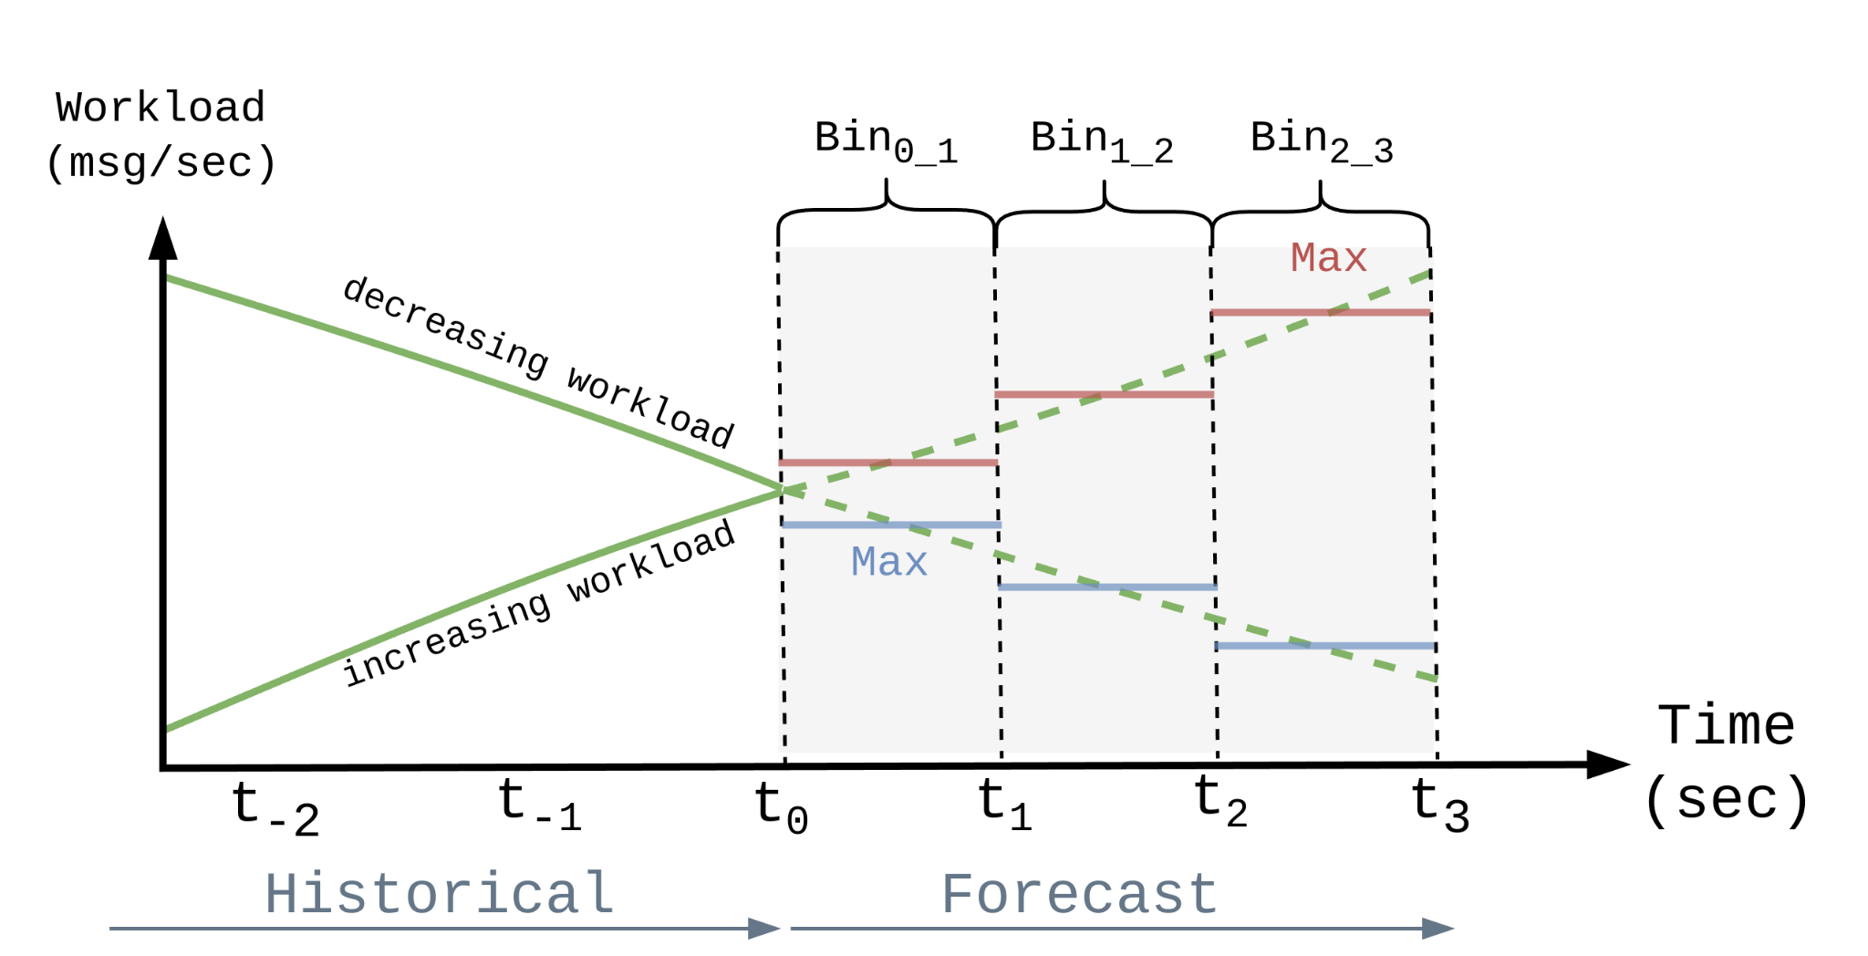
Approach:
Proactive Workload Predictions

Slide 11
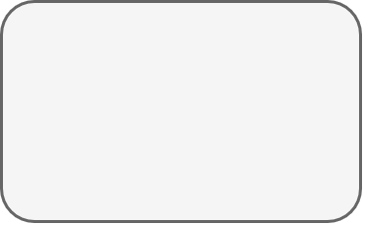
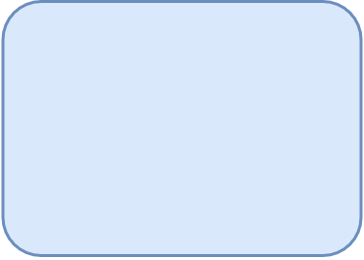
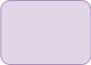
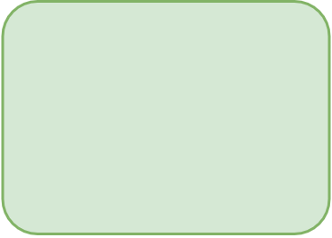
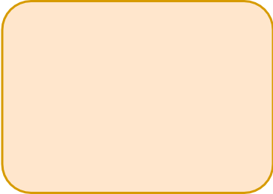
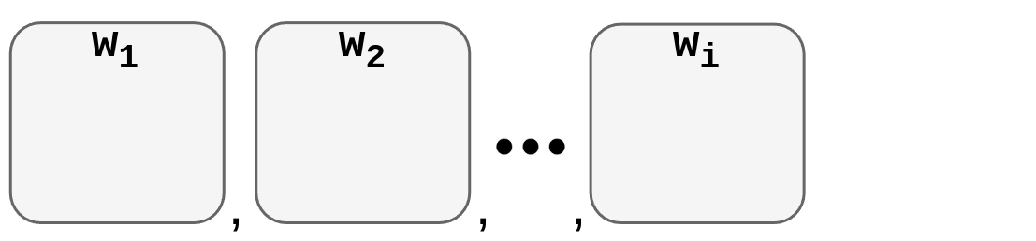
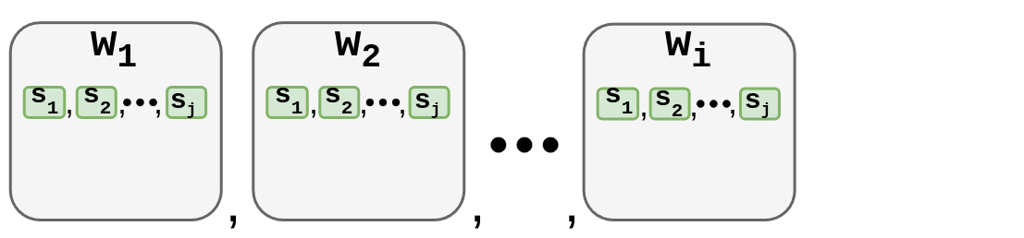
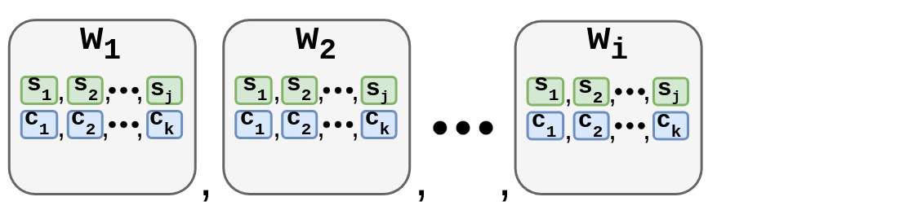
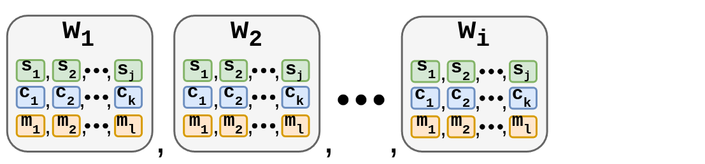
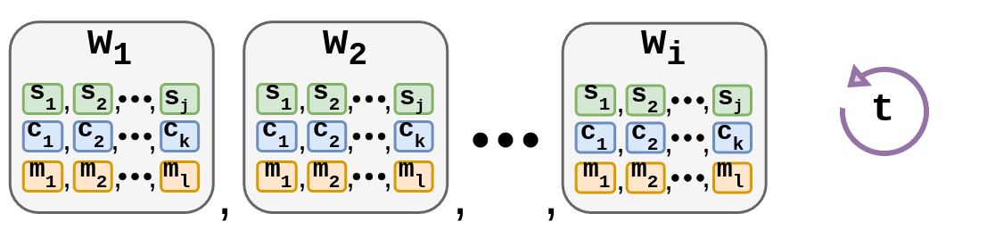
Approach:
Configuration Parameters
Workers (w)
CPU Cores (c)
Checkpoint Interval (t)
Task Slots (t)
Memory (m)
Notes:
Set of configuration parameters applied to all DSP systems.

Slide 12
Evaluation:
Experimental Setup
Experiments (Kubernetes + Apache Flink):
Yahoo Streaming Benchmark (click-stream analytics; 25K - 100K)
Top Speed Windowing (traffic monitoring; 35K - 125K)
Baselines & Configuration Space:
Method | Workers | Task Slots | CPU Cores | Memory (mb) | Checkpoint Interval (s)
Static (C_{max}) | 24 | 1 | 1 | 4096 | 10
Reactive | 1 - 24 | 1 | 1 | 4096 | 10
DS2 | 1 - 24 | 1 | 1 | 4096 | 10
Demeter | 1 - 24 | 1 - 4 | 1 - 3 | 1024 - 4096 | 10 - 90
18h experiment length; 23 failures; 180s recovery time constraint
Notes:
segment size (𝑆𝑆), safety buffer (𝑆𝐵), and efficiency threshold (𝐸𝑇)
18 hours

Slide 13
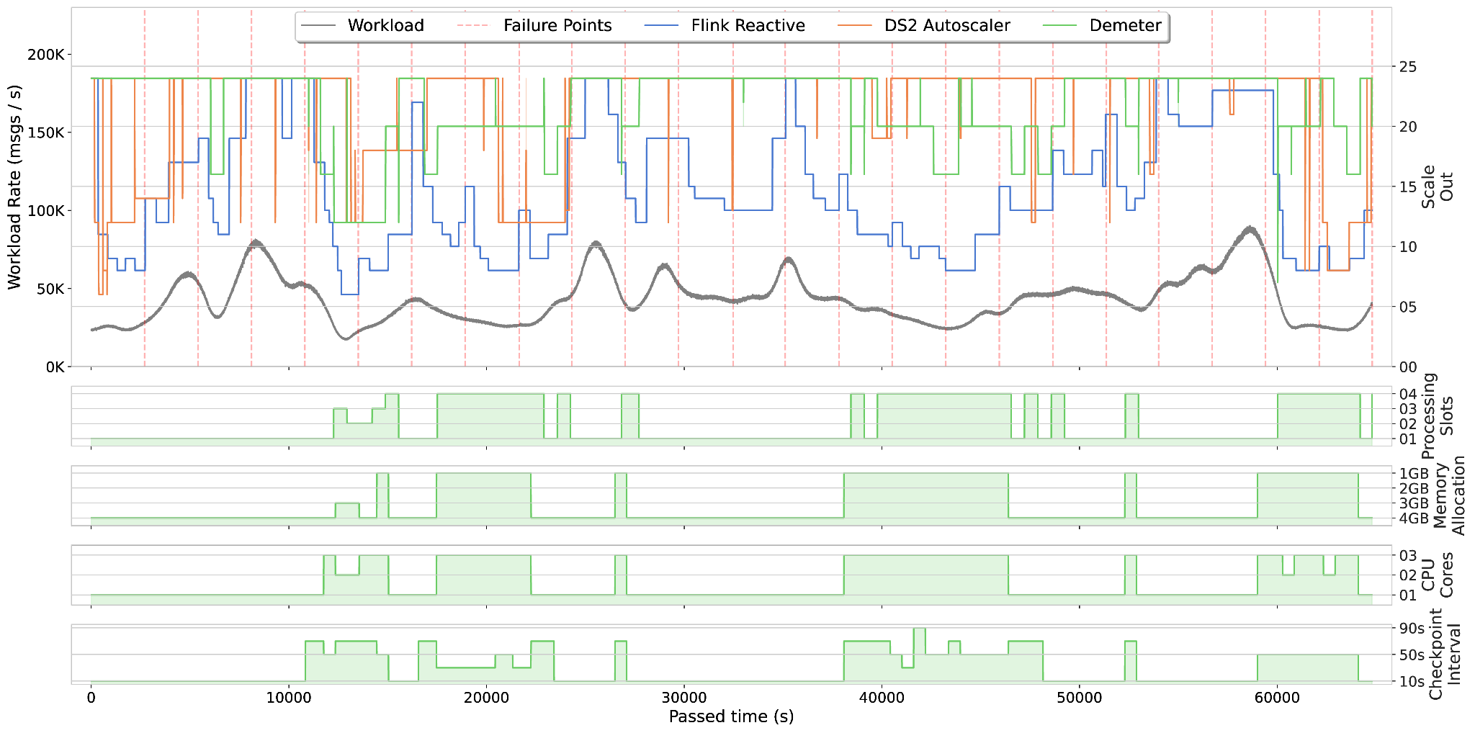
Evaluation:
Workload, Failures, & Configuration Parameters
YSB Experiment
Notes:
18

Slide 14

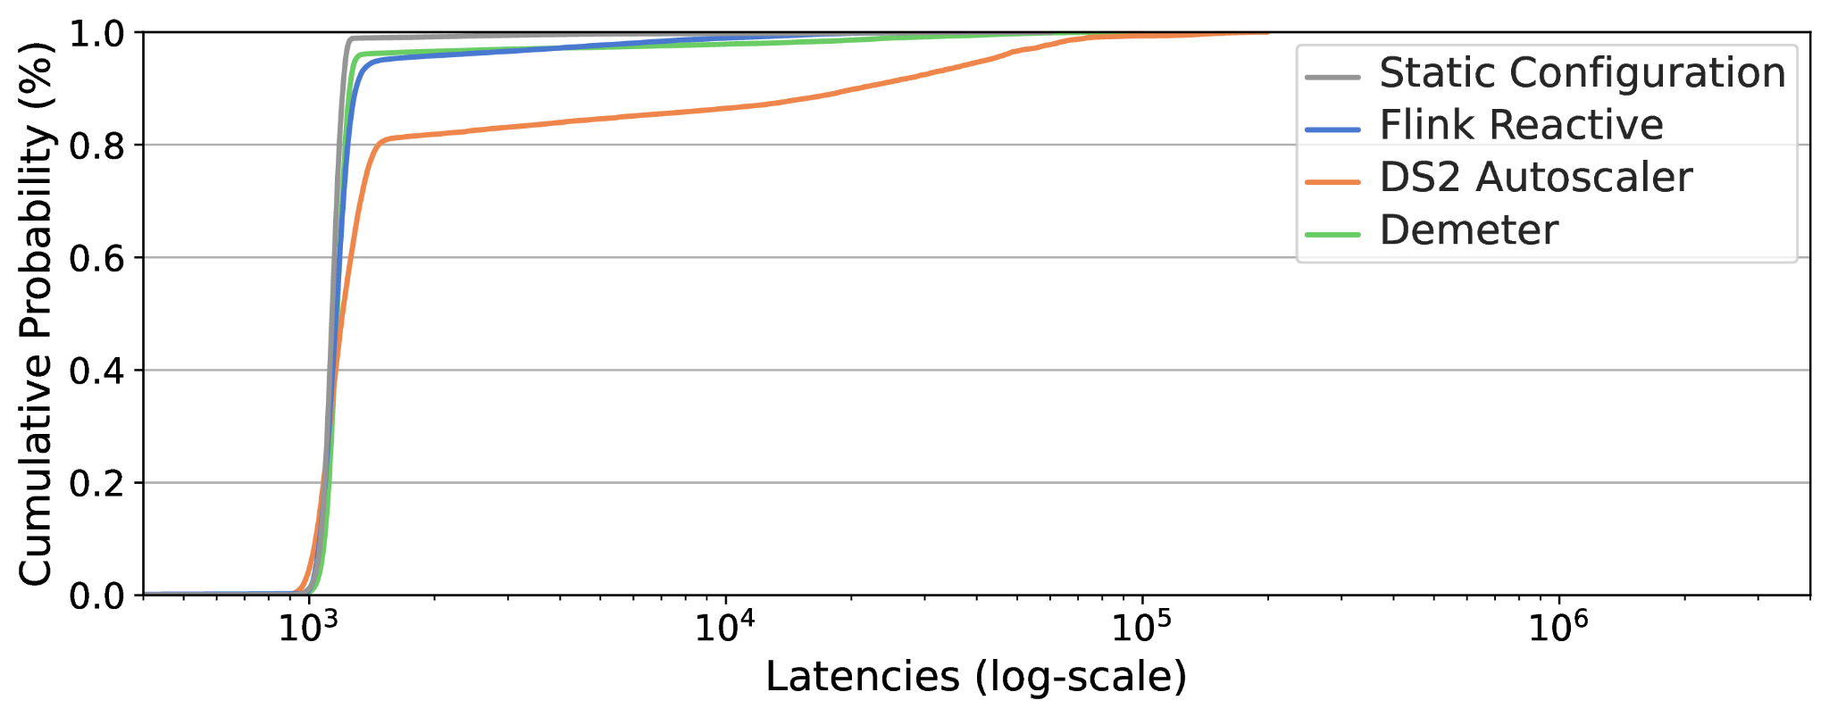
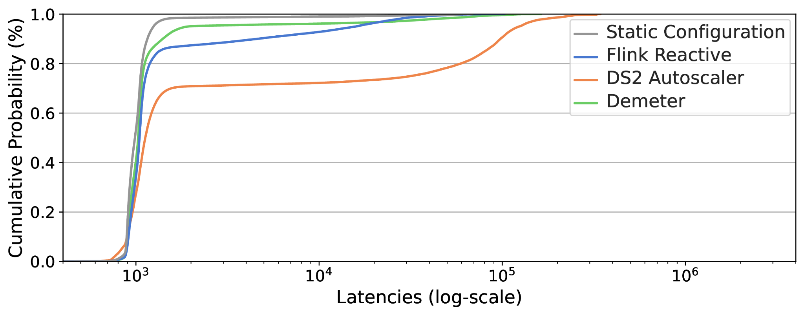
Evaluation:
End-to-end Latencies Comparison
YSB Experiment
TSW Experiment
1st: Static with near-optimal L_{avg} ≈ 1000ms
2nd: Demeter at 95% of near-optimal
3rd: Reactive at 94% of near-optimal
4th: DS2 at 82% of near-optimal
1st: Static with near-optimal L_{avg} ≈ 1000ms
2nd: Demeter at 95% of near-optimal
3rd: Reactive at 85% of near-optimal
4th: DS2 at 70% of near-optimal
Notes:
Cumulative distribution graph, with log scaling

Slide 15
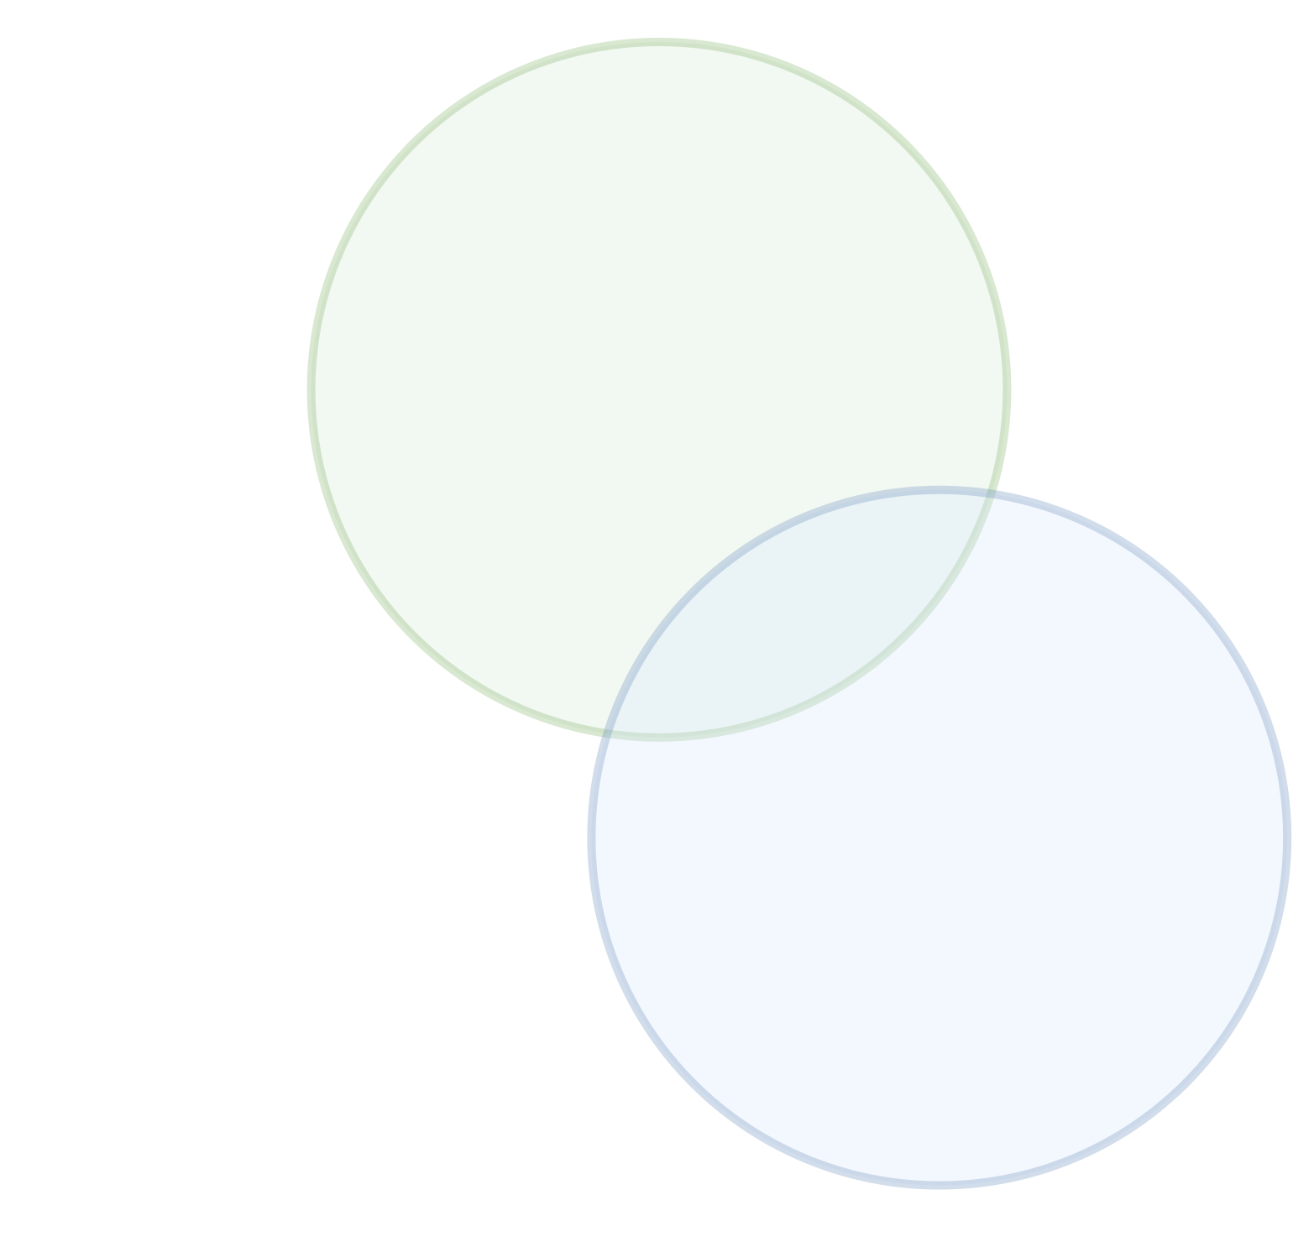


Evaluation:
Recovery Time Comparison
YSB Experiment
Recovery time averages: 1st Static 96s, 2nd Demeter 99s (0.03), 3rd Reactive 176s (0.83), 4th DS2 171s (0.78)
TSW Experiment
Recovery time averages: 1st Static 107s, 2nd Demeter 113s (0.05), 3rd DS2 162s (0.52), 4th Reactive 174s (0.63)

Slide 16



Evaluation:
Resource Usage Comparison
YSB Experiment
TSW Experiment

Slide 17
Summary
Demeter: Multi-configuration resource optimization for DSP jobs
Dynamic workloads
Exactly-once processing guarantees
Experiments showed that Demeter is able to:
Deliver a stable near-optimal service
Recover reliably from failures
Improve resource utilization
Future Work:
Improve the efficiency of the bayesian optimization component
Implement bayesian optimization component using GPU resources
Perform extended execution runs to observe efficiency over time
Notes:
An approach which uses TSF to optimize the resource utilization of DSP jobs executing in environments where the workload is expected to change over time.
Phoebe is applicable to scenarios where results are expected to be consistent in the presence of partial failures, i.e. where exactly-once processing is guaranteed.

Slide 18

Thank you
Have a great conference!
Morgan K. Geldenhuys
Researcher @ DOS
https://www.dos.tu-berlin.de
morgan.geldenhuys@tu-berlin.de

